Slide 1
LO To assess my understanding of constructing triangles and angle facts. | RAG
Key Words: Reflect, Communicate, Explain, Justify | 07/12/2014
Starter Activity
Complete the ‘Heard the Word Grid.’
Are there any key words that you have learnt or have a better understanding of now than you did at the start of this unit of work?

Slide 2
Grade | F | E | D | C | B | A/A*
Angle s and Circle Theorems | I am able to draw and measure angles using a protractor. I can recognise and label types of triangle. I can recognise and label types of angles. | I know that the sum of angles in a triangle is 180 degrees and the sum of the angles in a quadrilateral is 360 degrees. I can calculate missing angles in triangles and quadrilaterals, around a point and on a straight line. | I can solve simple problems to calculate missing interior and exterior angles in polygons. I can solve simple problems to calculate missing angles on parallel lines. | I can solve multi step problems to find interior and exterior angles in polygons. I can solve multi step problems to find missing angles on parallel lines. | I can find angles in circles. | I can find angles in circles using the alternate segment theorem (A). I can use circle theorems to prove geometrical results (A*).

Slide 3
Key Words / symbols | Never heard before? | Heard of but not sure what it means? | Know what it means and can explain it in context Jot down your ideas here...
Corresponding
Alternate
Interior
Exterior
Vertically Opposite
Same Segment Theorem
Alternate Segment Theorem
Cyclic Quadrilateral
Notes:
Print slides 3-10 two slides to a page.

Slide 4
Grade F Questions
Write down the special name for this type of angle. Measure the angle and write down the size to the nearest degree ……………………………. | What do you need to know before you can be sure if a triangle is isosceles, equilateral or scalene?
Write down the special name for this type of angle. Measure the angle and write down the size to the nearest degree ……………………………. | What is the special name for this type of triangle? Write down one fact about this type of triangle.
Notes:
Print slides 2-10 two slides to a page.

Slide 5
Grade E Questions
What can you tell me about the angles in any triangle. | Is it possible for a triangle to have angles of the sizes shown? Explain your answer.
Is it possible for a triangle to have more than one obtuse angle? Explain your answer. | What is different about a scalene triangle and an isosceles triangle?
Diagram not drawn accurately.
40⁰
80⁰
70⁰
Notes:
Print slides 2-10 two slides to a page.

Slide 6
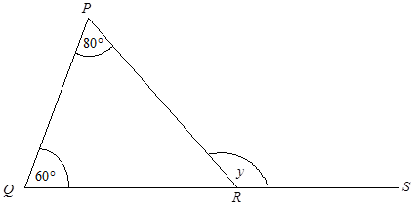
Grade E Questions
An isosceles triangle has one angle of 30⁰ Is this enough information to know the size of the other two angles? Why? | PQR is a triangle. QRS is a straight line. Find the size of the angle marked y. y = .....................° Give a reason for your answer.
Diagram not drawn accurately.
Diagram not drawn accurately.
30⁰
Notes:
Print slides 2-10 two slides to a page.

Slide 7
Grade E Questions
What can you tell me about the angles in any triangle. | Is it possible for a triangle to have angles of the sizes shown? Explain your answer.
Is it possible for a triangle to have more than one obtuse angle? Explain your answer. | What is different about a scalene triangle and an isosceles triangle?
Diagram not drawn accurately.
40⁰
80⁰
70⁰
Notes:
Print slides 2-10 two slides to a page.

Slide 8
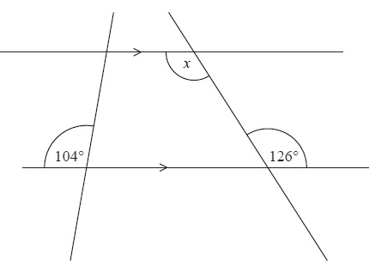
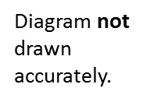
Grade D Questions
Work out the size of angle x Give a reason for your answer.
Here is a Regular Pentagon. What is the sum of the interior angles? What is the size of one interior angle? What is the size of one exterior angle? Give reasons for your answers.
Notes:
Print slides 2-10 two slides to a page.

Slide 9
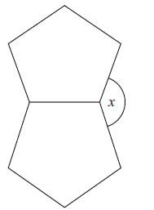
Grade C Questions
The diagram shows two regular shapes. Work out the size of the angle marked x. You must show how you got your answer.
The diagram shows 3 sides of a regular polygon. Diagram NOT accurately drawn Each interior angle of the regular polygon is 140°. Work out the number of sides of the regular polygon. Work out the size of an exterior angle. You must show how you got your answers.
Diagram not drawn accurately.
Notes:
Print slides 2-10 two slides to a page.

Slide 10
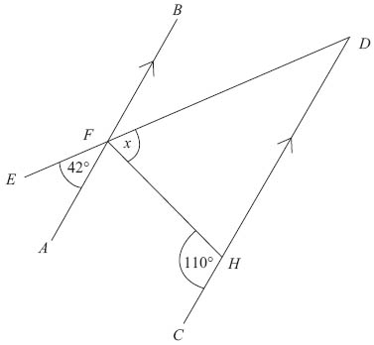
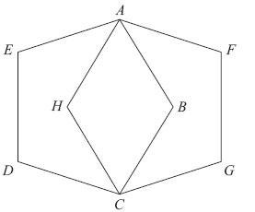
Grade C Questions
Work out the size of angle x. You must show how you got your answer.
ABCDE and AFGCH are regular pentagons. The two pentagons are the same size. Work out the size of angle EAH. You must show how you got your answer.
Diagram not drawn accurately.
Diagram not drawn accurately.
Notes:
Print slides 2-10 two slides to a page.

Slide 11
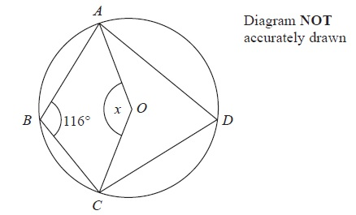
Grade B Question
A, B, C and D are points on the circumference of a circle with centre O. Angle ABC = 116° Find the size of the angle marked x. Give reasons for your answer.
Notes:
Print slides 2-10 two slides to a page.

Slide 12
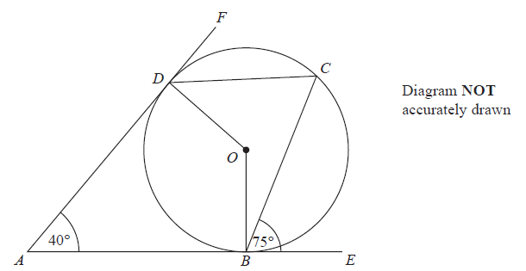
Grade B Question
B, C and D are points on the circumference of a circle, centre O. AB and AD are tangents to the circle. Angle DAB = 50° Work out the size of angle BCD. Give a reason for each stage in your working.
Notes:
Print slides 2-10 two slides to a page.

Slide 13
Grade A/A* Question
What is the size of: Angle x? Angle y?
Diagram not accurately drawn.
Notes:
Print slides 2-10 two slides to a page.

Slide 14
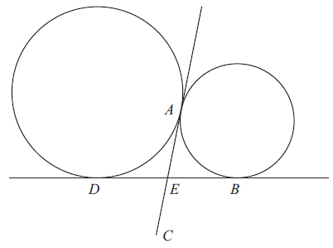
Grade A* Question
A and D are two points on the circumference of a circle. A and B are two points on the circumference of a smaller circle. DB and AC are tangents to both circles. E is the intersection of DB and AC. E is the midpoint of AC. Prove that ABCD is a rectangle.
Notes:
Print slides 2-10 two slides to a page.

Slide 15
Use the space below to set yourself a question similar to the ones you were able to answer confidently. | Use the space below to answer the question that you have set yourself
My own question… | My answer…
My own question… | My answer…

Slide 16
Grade | F | E | D | C | B | A/A*
Angle s and Circle Theorems | I am able to draw and measure angles using a protractor. I can recognise and label types of triangle. I can recognise and label types of angles. | I know that the sum of angles in a triangle is 180 degrees and the sum of the angles in a quadrilateral is 360 degrees. I can calculate missing angles in triangles and quadrilaterals, around a point and on a straight line. | I can solve simple problems to calculate missing interior and exterior angles in polygons. I can solve simple problems to calculate missing angles on parallel lines. | I can solve multi step problems to find interior and exterior angles in polygons. I can solve multi step problems to find missing angles on parallel lines. | I can find angles in circles. | I can find angles in circles using the alternate segment theorem (A). I can use circle theorems to prove geometrical results (A*).
Use the learning journey above to highlight the mathematical skills that you have now which you didn’t have at the start of the unit of work.
How much progress have you made?
What can you do to improve your skills as a learner in order to make even better progress?
Notes:
Dialogue marking sheet.

Slide 17
My teachers probing question | My answer
What I will do to act upon my ‘Even Better If’’ comment
Strategy |  | Tick / Comments
Complete a mymaths lesson or booster pack
Use a revision guide or text book
Ask my teacher to explain during a lesson
Ask a peer to explain during a lesson
Ask someone at home to help
Attend a revision session at school
Attend homework club
Something else (describe your strategy here)
Notes:
Dialogue marking sheet.

