Slide 1
LO To assess my understanding of constructing triangles and angle facts. | RAG
Key Words: Reflect, Communicate, Explain, Justify | 16/11/2014
Starter Activity
Complete the ‘Heard the Word Grid.’
Are there any key words that you have learnt or have a better understanding of now than you did at the start of this unit of work?

Slide 2
Level | 4 | 5 | 6 | 7
Constructing Triangles and Angle Facts | I am able to draw and measure angles using a protractor. I can recognise and label types of triangle. I can recognise and label types of angles. | I can calculate ‘missing angles’ in triangles. I can calculate angles on a straight line or at a point. | I can use my knowledge about the sum of the interior angles of a triangle to find the sum of the interior angles of polygons. I can calculate interior and exterior angles of polygons. I can calculate missing angles on parallel lines. I can construct triangles to scale using ruler and protractor (SAS, ASA) and using straight edge and compasses (SSS). | I can solve multi step problems involving interior and exterior angles of polygons. I can solve multi step problems involving angles on parallel lines.

Slide 3
Key Words / symbols | Never heard before? | Heard of but not sure what it means? | Know what it means and can explain it in context Jot down your ideas here… It may help to draw a diagram
Acute Angle
Obtuse Angle
Reflex Angle
Right Angle
Equilateral Triangle
Isosceles Triangle
Scalene Triangle
Right Angle Triangle
Notes:
Print slides 3-10 two slides to a page.

Slide 4
Key Words / symbols | Never heard before? | Heard of but not sure what it means? | Know what it means and can explain it in context Jot down your ideas here… It may help to draw a diagram
Alternate Angles
Corresponding Angles
Vertically Opposite Angles
Interior Angles
Exterior Angles
Regular Polygon
Notes:
Print slides 3-10 two slides to a page.

Slide 5
Level 4 Questions
Write down the special name for this type of angle. Measure the angle and write down the size to the nearest degree ……………………………. | What do you need to know before you can be sure if a triangle is isosceles, equilateral or scalene?
Write down the special name for this type of angle. Measure the angle and write down the size to the nearest degree ……………………………. | What is the special name for this type of triangle? Write down one fact about this type of triangle.
Notes:
Print slides 3-14 two slides to a page.

Slide 6
Level 5 Questions
What can you tell me about the angles in any triangle. | Is it possible for a triangle to have angles of the sizes shown? Explain your answer.
Is it possible for a triangle to have more than one obtuse angle? Explain your answer. | What is different about a scalene triangle and an isosceles triangle?
Diagram not drawn accurately.
40⁰
80⁰
70⁰
Notes:
Print slides 2-10 two slides to a page.

Slide 7
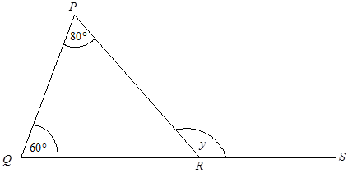
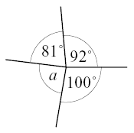
Level 5 Questions
An isosceles triangle has one angle of 30⁰ Is this enough information to know the size of the other two angles? Why? | PQR is a triangle. QRS is a straight line. Find the size of the angle marked y. y = .....................° Give a reason for your answer.
Calculate the size of angle a. Explain how you worked it out.
Diagram not drawn accurately.
Diagram not drawn accurately.
Notes:
Print slides 2-10 two slides to a page.

Slide 8
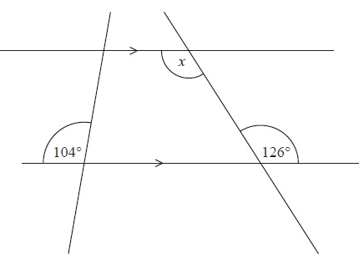
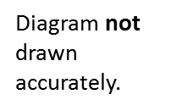
Level 6 Questions
Work out the size of angle x Give a reason for your answer.
Here is a Regular Pentagon. What is the sum of the interior angles? What is the size of one interior angle? What is the size of one exterior angle? Give reasons for your answers.
Notes:
Print slides 2-10 two slides to a page.

Slide 9
Level 6 Question
Here is a triangle. Make an accurate drawing of triangle ABC.
Notes:
Print slides 2-10 two slides to a page.

Slide 10
Level 6 Question
In the space below, use ruler and compasses to construct an equilateral triangle with sides of length 5 cm. You must show all your construction lines.
Notes:
Print slides 2-10 two slides to a page.

Slide 11
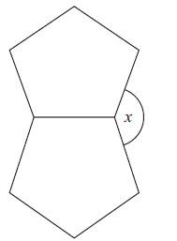
Level 7 Questions
The diagram shows two regular shapes. Work out the size of the angle marked x. You must show how you got your answer.
The diagram shows 3 sides of a regular polygon. Diagram NOT accurately drawn Each interior angle of the regular polygon is 140°. Work out the number of sides of the regular polygon. Work out the size of an exterior angle. You must show how you got your answers.
Diagram not drawn accurately.
Notes:
Print slides 2-10 two slides to a page.

Slide 12
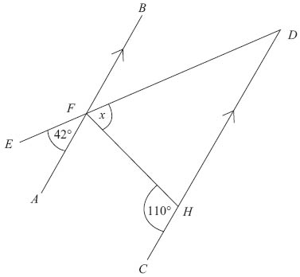
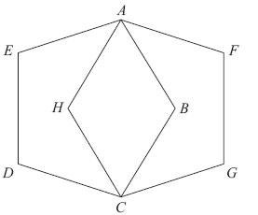
Level 7 Questions
Work out the size of angle x. You must show how you got your answer.
ABCDE and AFGCH are regular pentagons. The two pentagons are the same size. Work out the size of angle EAH. You must show how you got your answer.
Diagram not drawn accurately.
Diagram not drawn accurately.
Notes:
Print slides 2-10 two slides to a page.

Slide 13
Use the space below to set yourself a question similar to the ones you were able to answer confidently. | Use the space below to answer the question that you have set yourself
My own question… | My answer…
My own question… | My answer…

Slide 14
Level | 4 | 5 | 6 | 7
Constructing Triangles and Angle Facts | I am able to draw and measure angles using a protractor. I can recognise and label types of triangle. I can recognise and label types of angles. | I can calculate ‘missing angles’ in triangles. I can calculate angles on a straight line or at a point. | I can use my knowledge about the sum of the interior angles of a triangle to find the sum of the interior angles of polygons. I can calculate interior and exterior angles of polygons. I can calculate missing angles on parallel lines. I can construct triangles to scale using ruler and protractor (SAS, ASA) and using straight edge and compasses (SSS). | I can solve multi step problems involving interior and exterior angles of polygons. I can solve multi step problems involving angles on parallel lines.
Use the learning journey above to highlight the mathematical skills that you have now which you didn’t have at the start of the unit of work.
How much progress have you made?
What can you do to improve your skills as a learner in order to make even better progress?
Notes:
Dialogue marking sheet.

Slide 15
My teachers probing question | My answer
What I will do to act upon my ‘Even Better If’’ comment
Strategy |  | Tick / Comments
Complete a mymaths lesson or booster pack
Use a revision guide or text book
Ask my teacher to explain during a lesson
Ask a peer to explain during a lesson
Ask someone at home to help
Attend a revision session at school
Attend homework club
Something else (describe your strategy here)
Notes:
Dialogue marking sheet.

