Slide 1
LO To assess my understanding of fractions | RAG
Key Words: Reflect, Communicate, Explain, Justify | 10/01/2015
Starter Activity
Complete the ‘Heard the Word Grid.’
Are there any key words that you have learnt or have a better understanding of now than you did at the start of this unit of work?

Slide 2
Key Words / Methods | Never heard before? | Heard of but not sure what it means? | Know what it means and can explain it in context Jot down your ideas here...
Numerator
Denominator
Equivalent
Mixed Number
Top Heavy Fraction
Common Denominator

Slide 3
Level 3 Questions
Write down 3 fractions that are equivalent to (the same as) ½. | True or false $\frac{11}{21}$ is equivalent to (the same as) $\frac{1}{2}$ ? How do you know?
1
0
On the number line above mark the following fractions:
$\frac{1}{2}$ $\frac{1}{3}$ $\frac{1}{6}$

Slide 4
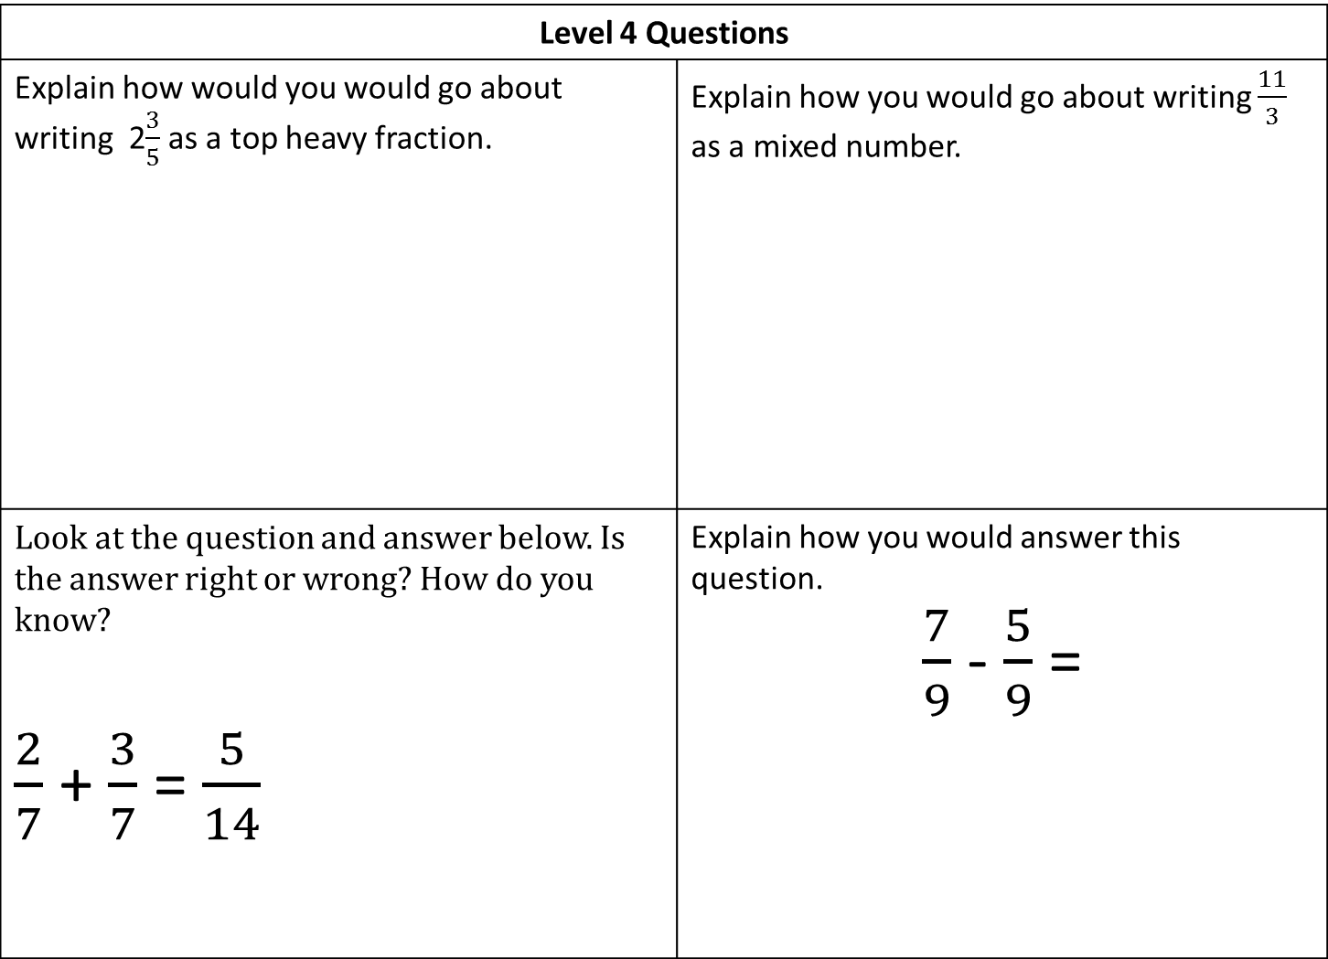
Level 4 Questions
Explain how would you would go about writing 2$\frac{3}{5}$ as a top heavy fraction. | Explain how you would go about writing $\frac{11}{3}$ as a mixed number.
Look at the question and answer below. Is the answer right or wrong? How do you know? $\frac{2}{7}$ + $\frac{3}{7}$ = $\frac{5}{14}$ | Explain how you would answer this question. $\frac{7}{9}$ - $\frac{5}{9}$ =

Slide 5
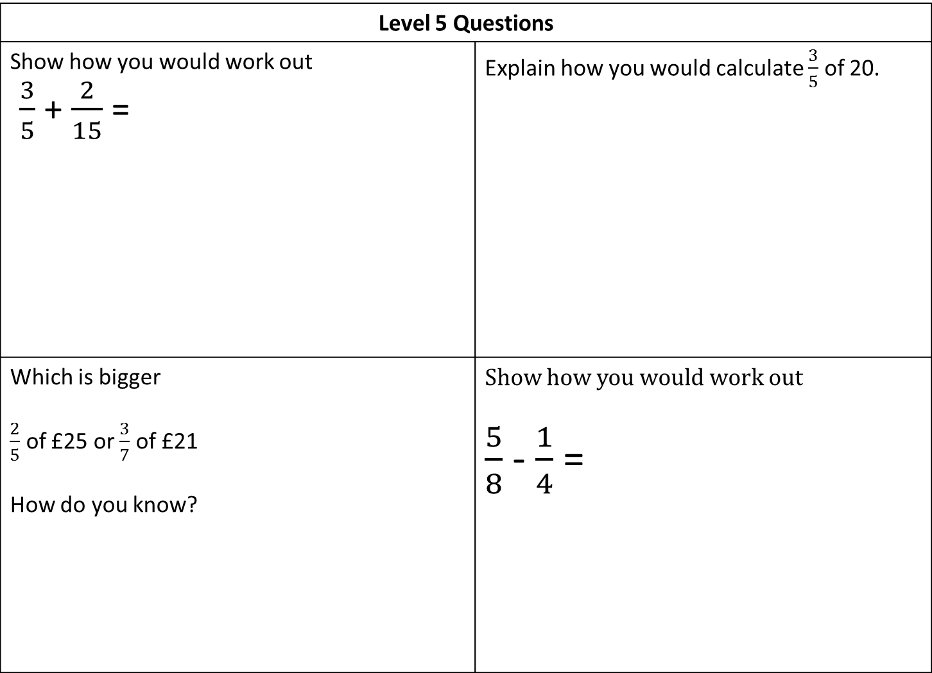
Level 5 Questions
Show how you would work out $\frac{3}{5}$ + $\frac{2}{15}$ = | Explain how you would calculate $\frac{3}{5}$ of 20.
Which is bigger $\frac{2}{5}$ of £25 or $\frac{3}{7}$ of £21 How do you know? | Show how you would work out $\frac{5}{8}$ - $\frac{1}{4}$ =

Slide 6
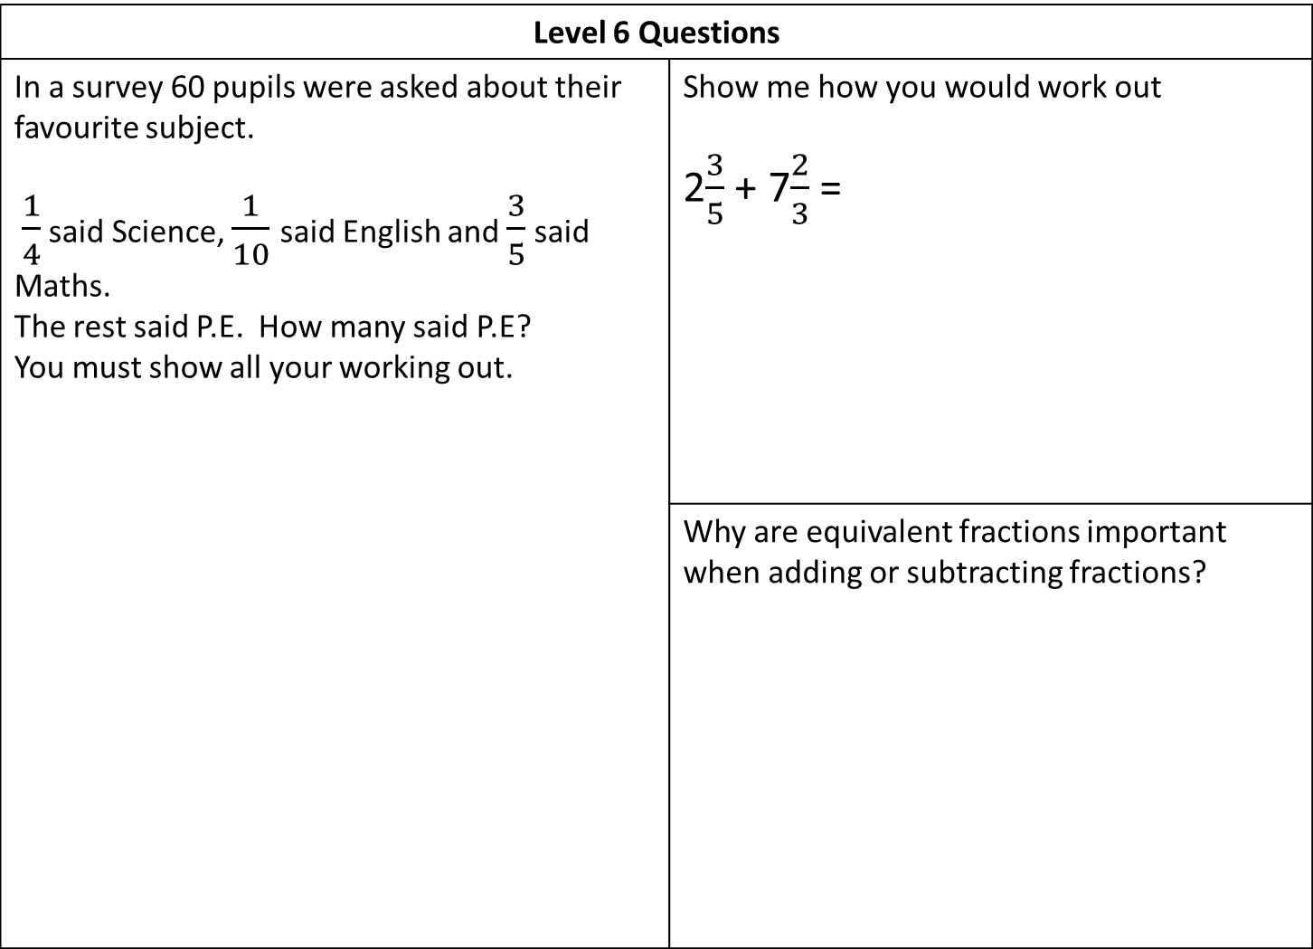
Level 6 Questions
In a survey 60 pupils were asked about their favourite subject. $\frac{1}{4}$ said Science, $\frac{1}{10}$ said English and $\frac{3}{5}$ said Maths. The rest said P.E. How many said P.E? You must show all your working out. | Show me how you would work out 2$\frac{3}{5}$ + 7$\frac{2}{3}$ =
 | Why are equivalent fractions important when adding or subtracting fractions?

Slide 7
Level 7 Questions
$\frac{3}{5}$ x $\frac{2}{3}$ = | $\frac{4}{7}÷\frac{2}{3}$ =
True/Never/Sometimes: ‘Multiplying two fractions together gives a bigger answer than either of the fractions you are multiplying.’ | Show me two fractions that multiplied together make a whole.

Slide 8
Level 8 Questions
Explore the pattern below and describe the pattern using algebra. $\frac{2}{3}$ - $\frac{1}{4}$ = $\frac{5}{12}$ $\frac{2}{4}$ - $\frac{1}{5}$ = $\frac{6}{20}$ $\frac{2}{5}$ - $\frac{1}{6}$ = $\frac{7}{30}$ $\frac{2}{6}$ - $\frac{1}{7}$ = $\frac{8}{42}$

Slide 9
My own questions and answers
My own question | My Answer
My own question | My Answer

Slide 10
Level 3 | Level 4 | Level 5 | Level 6 | Level 7 | Level 8
I understand and can use unit fractions e.g. 1/2, 1/4, 1/3, 1/5, 1/10 and find those fractions on number lines. I can recognise some fractions that are equivalent to ½ | I can convert mixed numbers to improper fractions and vice versa. I can express a smaller number as a fraction of a larger one. I can add and subtract fractions with a common denominator. | I can calculate fractions of an amount – e.g. 2/5 of 60 and ⅜ of 400g. I can add and subtract fractions when one denominator is a factor of the other one – e.g. 1/5 + 3/10 | I can add and subtract complex fractions, including mixed numbers – e.g. 2³/₇ + 3²/₁₁ | I understand and can use efficient methods to add, subtract, multiply and divide fractions, including mixed numbers and questions that involve more than one operation. | I can explore patterns involving fractions and describe the patterns using algebra.
Use the learning journey above to highlight the mathematical skills that you have now which you didn’t have at the start of the unit of work.
How much progress have you made?
What can you do to improve your skills as a learner in order to make even better progress?

Slide 11
My teachers probing question | My answer
What I will do to act upon my ‘Even Better If’’ comment
Strategy | Tick the strategy you will use.
Complete a mymaths lesson or booster pack
Use a revision guide or text book
Ask my teacher to explain during a lesson
Ask a peer to explain during a lesson
Ask someone at home to help
Attend a revision session at school
Attend homework club
Something else (describe your strategy here)
Notes:
Dialogue marking sheet.

