Slide 1
Pupil Flight Plan
 | Securing | Developing | Developing | Establishing | Establishing | Advancing | Advancing
Year 7 Autumn Term 1 Number Line | I can order numbers to 100 using key words such as greater, less than and in between. I can explain the importance of 0 as a place holder. | I can understand and use place value in numbers up to 1000. I can recognise negative numbers. I understand simple decimal notation. | I can order decimals to two or three places. I can use the concepts and vocabulary of factors (or divisors), multiples, and squares. I can round numbers to a power of 10. I understand and can use place value for decimals, measures and integers of any size. I can order positive and negative integers, decimals and fractions; use the number line as a model for ordering of the real numbers. | I can round numbers and measures to an appropriate degree of accuracy for example, to a number of decimal places or significant figures. I can use the concepts and vocabulary of prime numbers, highest common factor, lowest common multiple, prime factorisation. I appreciate the infinite nature of the sets of integers, real and rational numbers. I can use the symbols =, ≠, <, >, ≤, ≥ | I can use powers and roots (square, cube and higher). I can recognise powers of 2, 3, 4, 5 and distinguish between exact representations of roots and their decimal approximations. I can express a number as a product of its prime factors. I can work interchangeably with terminating decimals and their corresponding fractions . | I can use the concepts of product notation and the unique factorisation property. I can recognise which fractions are terminating decimals and which are recurring and give reasons why. | I can interpret and compare numbers in standard form A x 10^{n} 1≤A<10, where n is a positive or negative integer or zero.

Slide 2
LO To assess my understanding of using a number line
RAG
Key Words: Reflect, Communicate, Explain, Justify
18-Oct-14
Starter Activity
Complete the ‘Heard the Word Grid.’
Are there any key words or symbols that you have learnt or have a better understanding of now than you did at the start of this unit of work?
Notes:
2

Slide 3
 | Securing | Developing | Developing | Establishing | Establishing | Advancing
Number Line | I can order numbers to 100 using terms such as greater, less than and in between. | I understand simple decimal notation. | I can order decimals to two or three places. | I can match terminating decimals to fractions. | I can work interchangeably with terminating decimals and their corresponding fractions (such as 3.5 and 7/2 or 0.375 and 3/8) | I can recognise which fractions are terminating decimals and which are recurring and give reasons why.
This assessment task will assess your understanding of the skills described in the learning journey above.
These skills are including in your Autumn- Term 1 Flight Plan.

Slide 4
Key Words / symbols | Never heard before? | Heard of but not sure what it means? | Know what it means and can explain it in context Jot down your ideas here...
Integer
<
>
=
≠
Numerator
Denominator
Equivalent
Notes:
The slides should be printed 2 to a page on A4 paper.

Slide 5
Securing | Place these numbers in order from smallest to biggest using the number line below 23, 91, 34, 17, 56, 88.
 | Look at these two numbers 40 and 400. Complete the sentences opposite. | They are the same because…
 |  | They are different because…
 |  | The zeros are there to show ……
 | Always True /Sometimes True /Never True: A number with 9 units is going to be bigger than one with 6 units. Explain your answer.
100

Slide 6
Developing | Place these numbers in order from smallest to biggest using the number line below 123, 941, 534, 170, 506, 28
 | Look at these numbers -4 -7 2 Which is biggest? Which is smallest? What does the – sign in front of the 4 and the 7 mean?
1000

Slide 7
 | Question | Answer
Developing | Show me 3 numbers between 0.3 and 0.9
 | True or False 3.6 is the same as 3.60 Explain your answer.
 | Put these decimals in order from largest to smallest: 7.765, 7.675, 6.765, 7.756, 6.776
 | Convert these fractions into decimals 1⁄2 1⁄4 3⁄4 1⁄10 1⁄5 Show your working out.

Slide 8
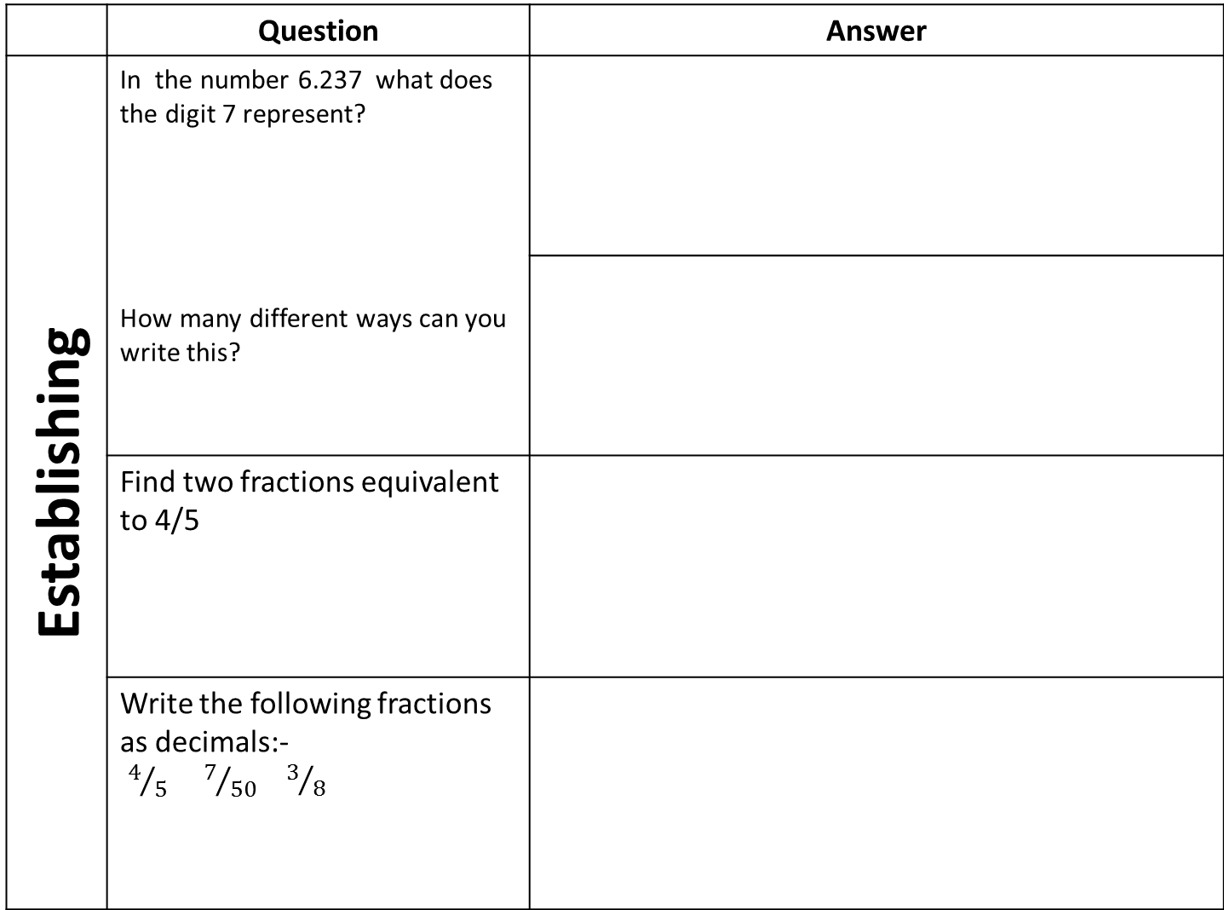
 | Question | Answer
Establishing | In the number 6.237 what does the digit 7 represent? How many different ways can you write this?
 | Find two fractions equivalent to 4/5
 | Write the following fractions as decimals:- $4/5$ $7/{50}$ ${ 3}/8$

Slide 9
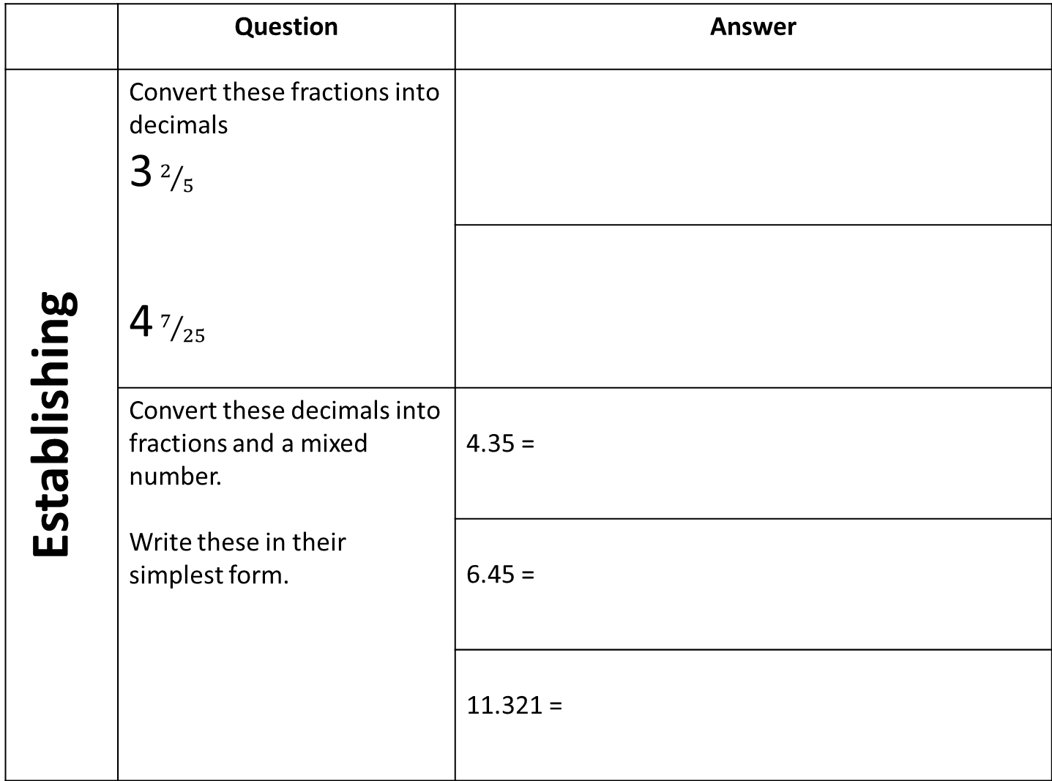
 | Question | Answer
Establishing | Convert these fractions into decimals 3 $2/5$ 4 $7/{25}$
 | Convert these decimals into fractions and a mixed number. Write these in their simplest form. | 4.35 =
 |  | 6.45 =
 |  | 11.321 =

Slide 10
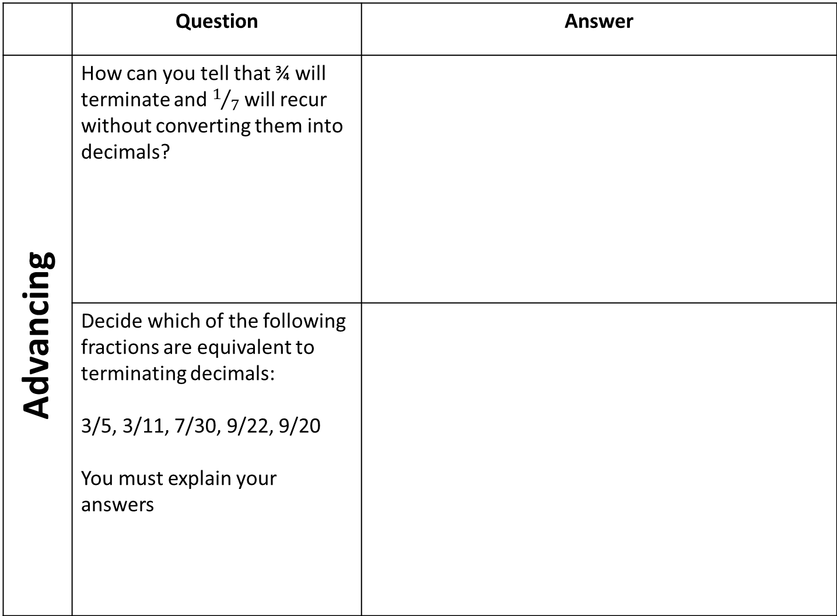
 | Question | Answer
Advancing | How can you tell that ¾ will terminate and $1/7$ will recur without converting them into decimals?
 | Decide which of the following fractions are equivalent to terminating decimals: 3/5, 3/11, 7/30, 9/22, 9/20 You must explain your answers

Slide 11
Use the space below to set yourself a question similar to the ones you were able to answer confidently. | Use the space below to answer the question that you have set yourself
My own question… | My answer…
My own question… | My answer…

Slide 12
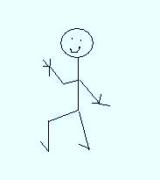
 | Securing | Developing | Developing | Establishing | Establishing | Advancing
Number Line | I can order numbers to 100 using terms such as greater, less than and in between. | I understand simple decimal notation. | I can order decimals to two or three places. | I can match terminating decimals to fractions. | I can work interchangeably with terminating decimals and their corresponding fractions (such as 3.5 and 7/2 or 0.375 and 3/8) | I can recognise which fractions are terminating decimals and which are recurring and give reasons why.
Use the learning journey above to highlight the mathematical skills that you have now which you didn’t have at the start of the unit of work.
How much progress have you made?
What can you do to improve your skills as a learner in order to make even better progress?
Notes:
Dialogue Marking Sheet

Slide 13
My teachers probing question | My answer
What I will do to act upon my ‘Even Better If’’ comment
Strategy | Tick the strategy you will use.
Complete a mymaths lesson or booster pack
Use a revision guide or text book
Ask my teacher to explain during a lesson
Ask a peer to explain during a lesson
Ask someone at home to help
Attend a revision session at school
Attend homework club
Something else (describe your strategy here)
Notes:
Dialogue marking sheet.

