Slide 1
LO To assess my understanding of number skills | RAG
Key Words: Reflect, Communicate, Explain, Justify | 15/11/2014
Starter Activity
Complete the ‘Heard the Word Grid.’
Are there any key words that you have learnt or have a better understanding of now than you did at the start of this unit of work?

Slide 2
Key Words / Methods | Never heard before? | Heard of but not sure what it means? | Know what it means and can explain it in context Jot down your ideas here...
Integer
Denominator
Numerator
Mixed Number
Common Denominator
Negative Number

Slide 3
Grade | G | F | E | D | C
Number Skills - Calculations | I know the times tables up to 10 x 10. I can add and subtract integers using written methods. I can add and subtract simple fractions. | I can multiply and divide 3 or 4 digit numbers by 1 digit numbers. I can multiply and divide two digit numbers by two digit numbers. I can multiply and divide whole numbers by 10 or 100. I can add and subtract decimal numbers to two decimal places. I can add and subtract more difficult fractions. | I can multiply and divide decimal numbers by a single digit. I can multiply and divide whole numbers and decimals by 10, 100 and 1000. I can solve simple problems involving ordering, adding, subtracting negative numbers in context. I can solve problems that involve multiplying and dividing any three digit number by any two-digit number. I can add and subtract mixed numbers. | I can multiply & divide with negative numbers. I can multiply and divide fractions. | I understand the effect of multiplying and dividing by numbers between 0 and 1

Slide 4
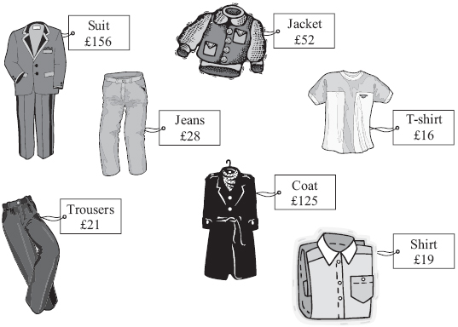
Grade G
Kylie and Roxy go shopping.
Kylie buys the coat and the T-shirt. Work out the total cost. £ . . . . . . . . . . . . . . . . . . . . . . | Roxy buys two items of clothing. She pays with £50 She gets £3 change. Which two items did Roxy buy?

Slide 5
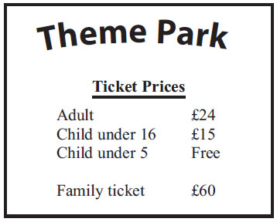
Grade G
Mr and Mrs Pickard and their two children, Lena and Adam, go to a theme park. Here are the ticket prices for the theme park. Lena is 8 years old. Adam is 4 years old. They can get a family ticket or they can get 4 separate tickets. It is cheaper to get a family ticket. How much cheaper?
Work out ⅕ + ⅗ = | Work out ⅜ - ⅛ = Write your answer in its simplest form.

Slide 6
Grade F
Work out ⅜ + ¼ | Michael sells cans of drink in his shop. The cans of drink are delivered in boxes to the shop. There are 24 cans of drink in a box. On Tuesday morning, Michael had no cans of drink in the shop. On Tuesday afternoon, 18 boxes of cans of drink were delivered to the shop. When the shop closed on Tuesday, Michael had 15 cans of drink left. How many cans of drink did Michael sell on Tuesday?
Complete these statements :- 4 x 10 = 4 x……. = 400 …….÷ 10 = 40 …….x 1000 = 40 000 ……..x 10 = 400

Slide 7
Grade E Questions
Wendy is putting sweets into packets. She has 5625 sweets. She puts 45 sweets in each packet. Wendy puts the packets of sweets into boxes. She puts 25 packets of sweets into each box. Work out the total number of boxes Wendy needs. . . . . . . . . . . . . . . . . . . . . . . boxes | Each packet of sweets weighs 690 g. An empty box weighs 260 g. There are 25 packets of sweets in each box. Work out the total weight of a full box of sweets. Give your answer in kilograms. . . . . . . . . . . . . . . . . . . . . . . kg

Slide 8
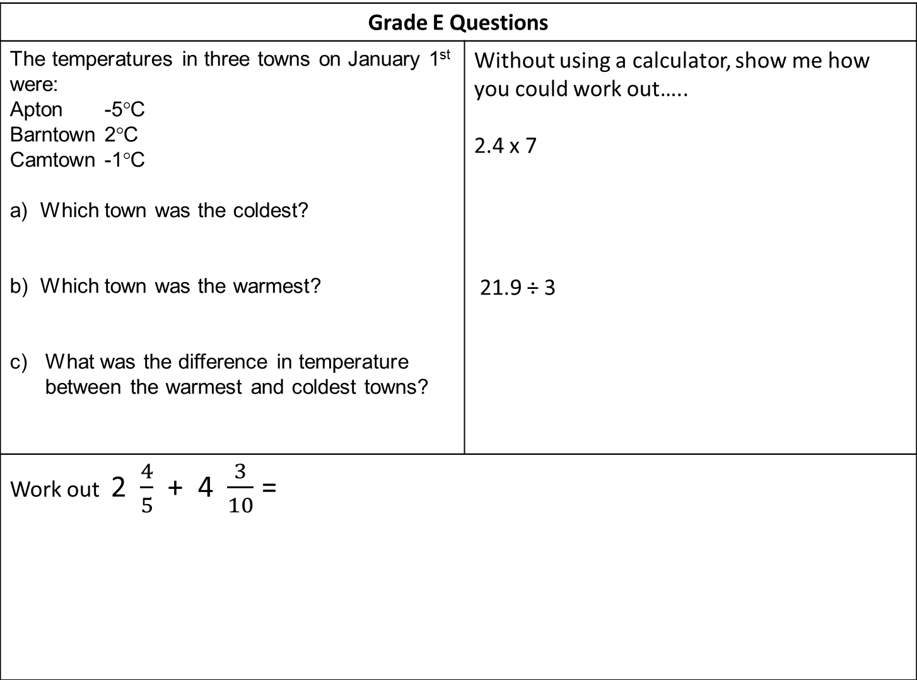
Grade E Questions
The temperatures in three towns on January 1st were: Apton -5°C Barntown 2°C Camtown -1°C a) Which town was the coldest? b) Which town was the warmest? What was the difference in temperature between the warmest and coldest towns? | Without using a calculator, show me how you could work out….. 2.4 x 7 21.9 ÷ 3
Work out 2 $\frac{4}{5}$ + 4 $\frac{3}{10}$ =

Slide 9
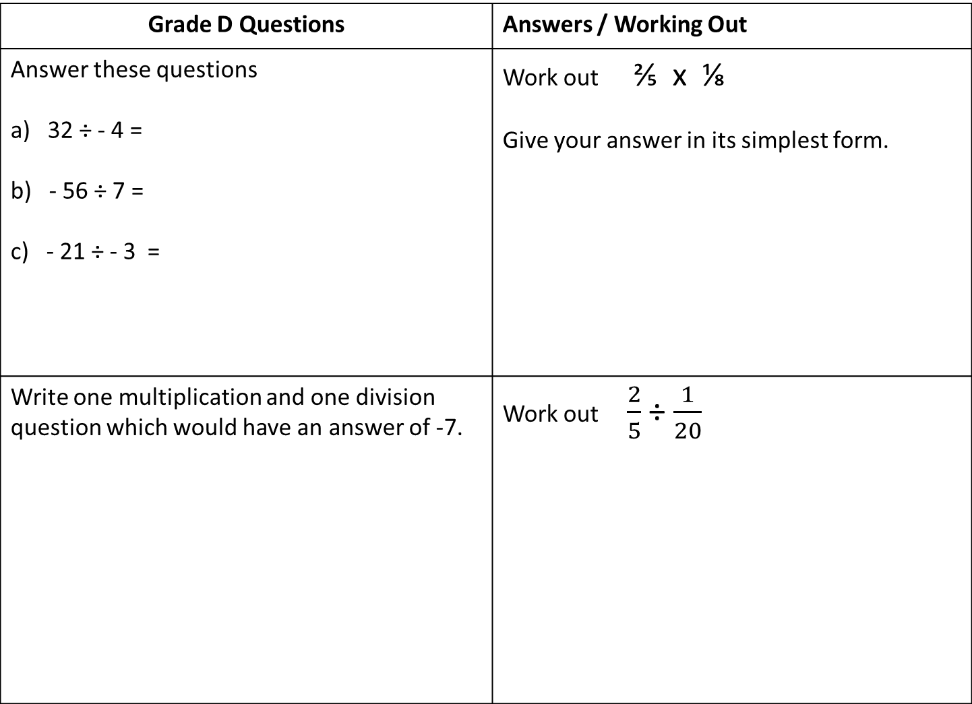
Grade D Questions | Answers / Working Out
Answer these questions a) 32 ÷ - 4 = b) - 56 ÷ 7 = c) - 21 ÷ - 3 = | Work out ⅖ x ⅛ Give your answer in its simplest form.
Write one multiplication and one division question which would have an answer of -7. | Work out $\frac{2}{5}$ ÷ $\frac{1}{20}$

Slide 10
Grade C
‘Multiplying makes numbers bigger.’ When is this statement true and when is it false? | ‘Dividing makes numbers smaller.’ When is this statement true and when is it false?
For each of these calculations explain the reasoning that took you to reach the answer :- 16 × 0.5 = 1.6 ÷ 0.5 = 1.6 ÷ 0.2 = 0.8 ÷ 0.1 =

Slide 11
Use the space below to set yourself a question similar to the ones you were able to answer confidently. | Use the space below to answer the question that you have set yourself
My own question… | My answer…
My own question… | My answer…

Slide 12
Grade | G | F | E | D | C
Number Skills - Calculations | I know the times tables up to 10 x 10. I can add and subtract integers using written methods. I can add and subtract simple fractions. | I can multiply and divide 3 or 4 digit numbers by 1 digit numbers. I can multiply and divide whole numbers by 10 or 100. I can add and subtract decimal numbers to two decimal places. I can add and subtract more difficult fractions. | I can multiply and divide decimal numbers by a single digit. I can multiply and divide whole numbers and decimals by 10, 100 and 1000. I can solve simple problems involving ordering, adding, subtracting negative numbers in context. I can solve problems that involve multiplying and dividing any three digit number by any two-digit number. I can add and subtract mixed numbers. | I can multiply & divide with negative numbers. I can multiply and divide fractions. | I understand the effect of multiplying and dividing by numbers between 0 and 1
Use the learning journey above to highlight the mathematical skills that you have now which you didn’t have at the start of the unit of work.
How much progress have you made?
What can you do to improve your skills as a learner in order to make even better progress?

Slide 13
My teachers probing question | My answer
What I will do to act upon my ‘Even Better If’’ comment
Strategy |  | Tick / Comments
Complete a mymaths lesson or booster pack
Use a revision guide or text book
Ask my teacher to explain during a lesson
Ask a peer to explain during a lesson
Ask someone at home to help
Attend a revision session at school
Attend homework club
Something else (describe your strategy here)
Notes:
Dialogue marking sheet.

