Slide 1
LO To assess my understanding of area and circumference of circles. | RAG
Key Words: Explain, Justify, Communicate | 04/05/2014
Grade | G/F | E | D | C | B
Circles | I know the words radius, diameter, circumference, chord and tangent. I can draw a circle when I know the radius . | I can calculate the circumference of a circle when I know the diameter. | I can calculate the area and circumference of a circle. I can calculate the radius and diameter of a circle when I know the Circumference. | I can calculate the area and perimeter of semi-circles and shapes made up of circles. I can calculate the volume of cylinders. | I can calculate the area of sectors. I can calculate the surface area and volume of cylinders and cones.

Slide 2
Grade | Question | Answer
G/F | Draw a circle with a radius of 5cm, using x as the centre. On your circle label the following:- Circumference Radius Diameter Chord Tangent x

Slide 3
Grade | Question | Answer
E
E
The diameter of the circle is 7cm. Explain how you would find the Circumference of the circle.
7cm
Jon has a flower garden in the shape of a circle. The diameter of the garden is 5 metres.
Jon wants to put fencing around the edge of the garden. The fencing costs £1.80 per metre.
Explain fully how you would work out the total cost of the fencing.

Slide 4
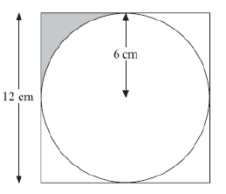
Grade | Question | Answer
D
D
The diameter of the circle is 12cm. Explain how you would find the Area of the circle.
7cm
The diagram shows a circle drawn inside a square.
The circle has a radius of 6cm.
The square has a side length of 12cm.
Work out the shaded area.
Give your correct to one decimal place.

Slide 5
Grade | My own question | Answer
E
D

Slide 6
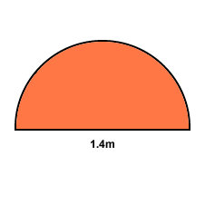
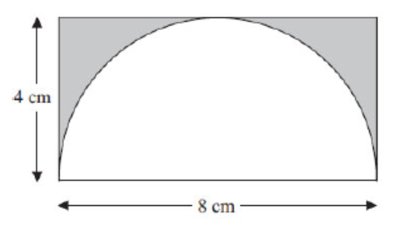
Grade | Question | Answer
C
C | Explain fully how you would go about working out the shaded area in the diagram above. Give your answers correct to one decimal place.
Jon thinks that the perimeter of the semi-circle above is 2.2 cm to one decimal place. Convince me that Jon is wrong and correct his answer. Can you see what mistake he has made?

Slide 7
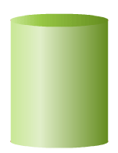
Grade | Question | Answer
C | Explain how you would work out the volume of the cylinder. Give your answer correct to one decimal place.
C
3
8
Here is a vase in the shape of a cylinder.
The vase has a radius of 5cm. There are 1000cm³ of water in the vase. Explain how you would work out the depth of the water in the vase. Give your answer correct to one decimal place.

Slide 8
Grade | My own question | Answer
C
B

Slide 9
Grade | G/F | E | D | C | B
Circles | I know the words radius, diameter, circumference, chord and tangent. I can draw a circle when I know the radius . | I can calculate the circumference of a circle when I know the diameter. | I can calculate the area and circumference of a circle. I can calculate the radius and diameter of a circle when I know the Circumference. | I can calculate the area and perimeter of semi-circles and shapes made up of circles. I can calculate the volume of cylinders. | I can calculate the area of sectors. I can calculate the surface area and volume of cylinders and cones.
I started this unit of work on grade _______
I am finishing this unit of work on grade ……………………….
This demonstrates…. excellent progress / good progress / some progress / I have not made progress , I need further work on this topic.
Notes:
Print slides 10 and 11 two to a page.

Slide 10
My teachers probing question | My answer
What I will do to act upon my ‘Even Better If’’ comment
Strategy |  | Tick / Comments
Complete a mymaths lesson or booster pack
Use a revision guide or text book
Ask my teacher to explain during a lesson
Ask a peer to explain during a lesson
Ask someone at home to help
Attend a revision session at school
Attend homework club
Something else (describe your strategy here)
Notes:
Dialogue marking sheet.

