Slide 1
LO To assess my understanding of Grouped Frequency Diagrams, Box Plots and Histograms | RAG
Key Words: Reflect, Communicate, Explain, Justify | 01/03/2015
Starter Activity
Complete the ‘Heard the Word Grid.’
Are there any key words that you have learnt or have a better understanding of now than you did at the start of this unit of work?

Slide 2

Grade | C | B | A | A*
Grouped Frequency Diagrams and Histograms | I can draw and interpret grouped frequency diagrams. | I can draw & interpret box plots. | I can draw Histograms from frequency tables with unequal class intervals. I can interpret Histograms | I can find the median, quartiles and interquartile range from a Histogram.

Slide 3

Key Words / symbols | Never heard before? | Heard of but not sure what it means? | Know what it means and can explain it in context Jot down your ideas here...
Lower quartile
Upper Quartile
Interquartile Range
Median
Grouped Frequency Diagram
Histograms
Frequency Density.

Slide 4
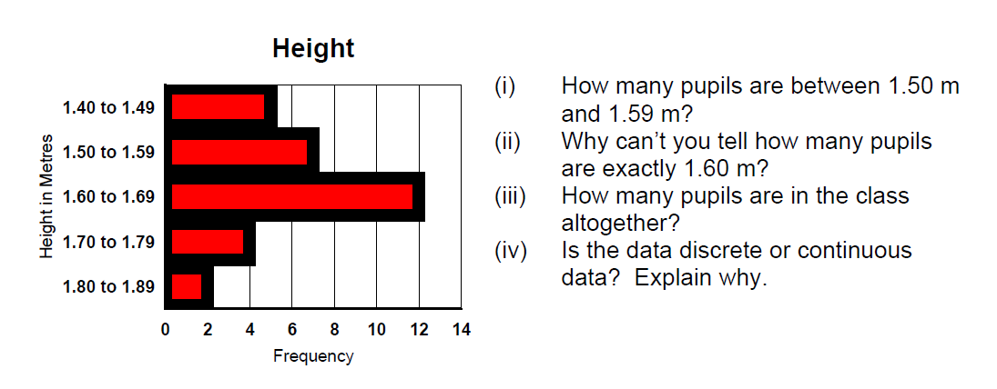
Grade C Questions
The frequency diagram opposite shows the heights of pupils in a class. (i) (ii) (iii) (iv)
14
12
10
8
Frequency
6
4
2
Height in m
Notes:
Print slides 2-10 two slides to a page.

Slide 5
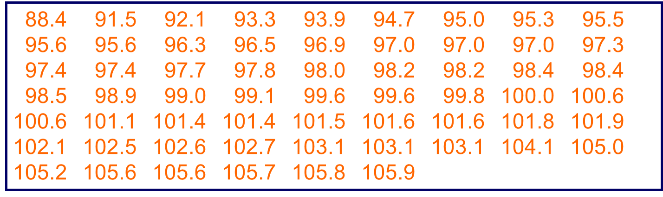
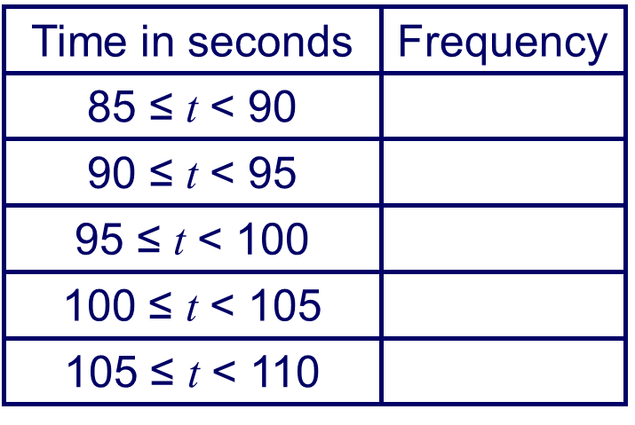
Grade C Questions
Here are some race times in seconds from a downhill racing event.
Complete the table and draw a frequency diagram to represent the results.
30
25
20
Frequency
15
10
5
0
80
85
90
95
100
105
Times in seconds
Notes:
Print slides 2-10 two slides to a page.

Slide 6
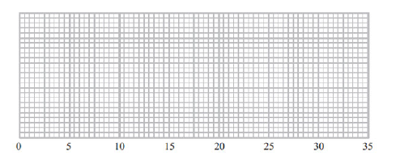
Grade B Questions
The table below shows information about the times, in minutes, a group of students took to answer 10 maths questions.
On the grid below draw a box plot to show the information in the table.
 | Least | Lower Quartile | Median | Upper Quartile | Greatest
Time in Minutes | 14 | 18 | 20 | 25 | 30
Notes:
Print slides 2-10 two slides to a page.

Slide 7
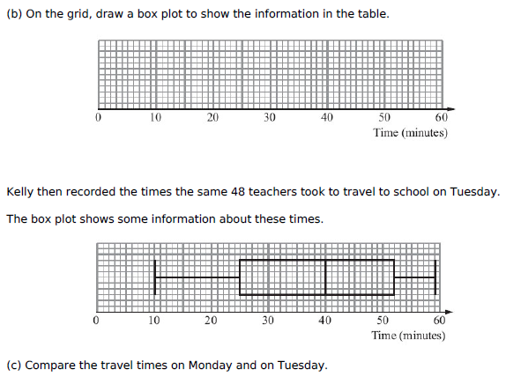
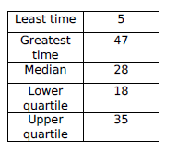
Grade B Questions
Kelly recorded the length of time 48 teachers took to travel to school on Monday. The table shows information about these travel times in minutes.
a) Work out the number of teachers with a travel time of 35 minutes or more.
Notes:
Print slides 2-10 two slides to a page.

Slide 8
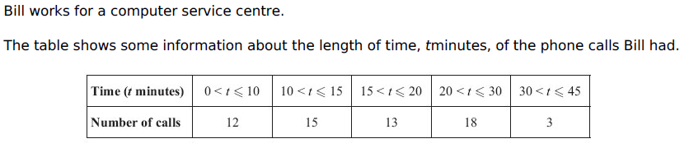
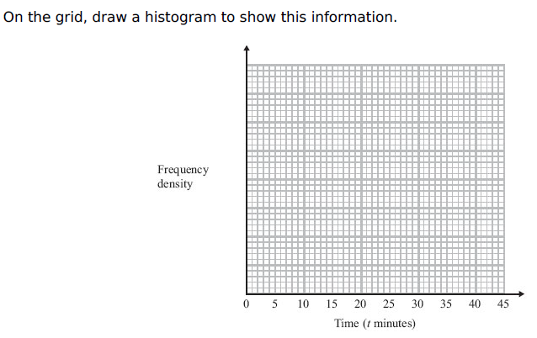
Grade A Questions
Notes:
Print slides 2-10 two slides to a page.

Slide 9
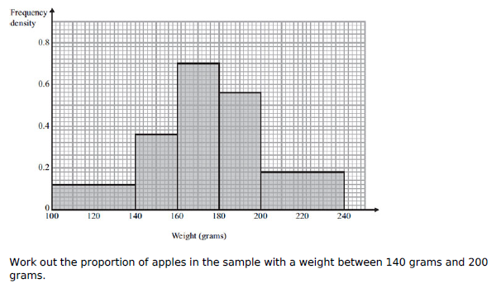
Grade A Questions
Notes:
Print slides 2-10 two slides to a page.

Slide 10
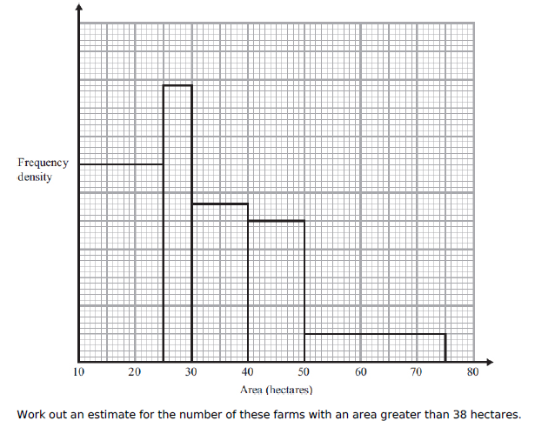
Grade A* Questions
Notes:
Print slides 2-10 two slides to a page.

Slide 11
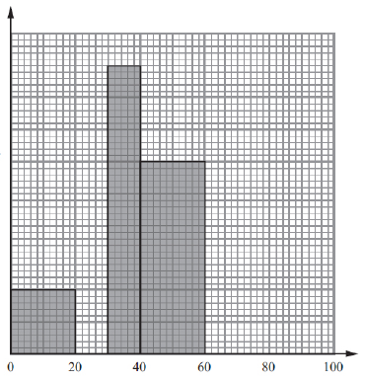
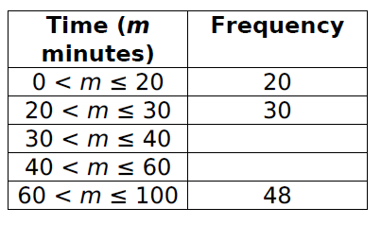
Grade A* Questions
The table and the histogram show information about the time in minutes, taken by a group of students to travel to college in one week.
Frequency Density
Use the histogram to complete the table.
Use the table to complete the histogram.
Work out an estimate for the median time.
Calculate the interquartile range.
Time in Minutes
Notes:
Print slides 2-10 two slides to a page.

Slide 12
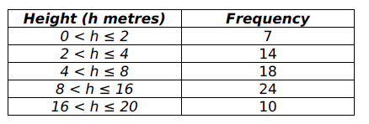
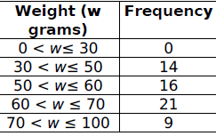
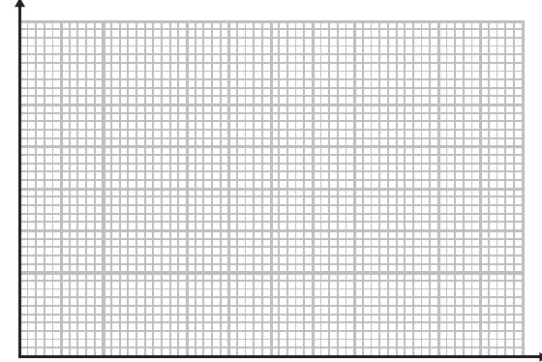
Choose one of the data sets below to set yourself a question and answer it. Your question should be similar to the ones you were able to answer confidently.

Slide 13
Grade | C | B | A | A*
Grouped Frequency Diagrams and Histograms | I can draw and interpret grouped frequency diagrams. | I can draw & interpret box plots. | I can draw Histograms from frequency tables with unequal class intervals. I can interpret Histograms | I can find the median, quartiles and interquartile range from a Histogram.
Use the learning journey above to highlight the mathematical skills that you have now which you didn’t have at the start of the unit of work.
How much progress have you made?
What can you do to improve your skills as a learner in order to make even better progress?

Slide 14
My teachers probing question | My answer
What I will do to act upon my ‘Even Better If’’ comment
Strategy |  | Tick / Comments
Complete a mymaths lesson or booster pack
Use a revision guide or text book
Ask my teacher to explain during a lesson
Ask a peer to explain during a lesson
Ask someone at home to help
Attend a revision session at school
Attend homework club
Something else (describe your strategy here)
Notes:
Dialogue marking sheet.

