Slide 1
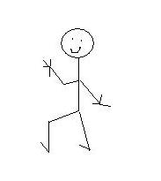
On your mini whiteboards draw this scale
Often
Never
Sometimes
Notes:
Ask pupils to use the scale to show how often they have felt the following ways in a Maths lesson….

Slide 2
In your Maths lessons, how often do you hear yourself thinking
I can’t do this…
Notes:
Before showing students the next slide ask if they can suggest an alternative way of thinking.

Slide 3
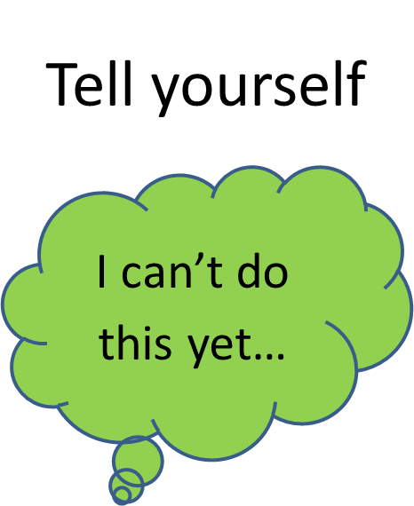

Slide 4
In your Maths lessons, how often do you hear yourself thinking
I can’t do this…
Notes:
Before showing students the next slide ask if they can suggest an alternative way of thinking.

Slide 5
Tell yourself
I can’t do this yet…

Slide 6
In your Maths lessons, how often do you hear yourself thinking
I’m no good at this…

Slide 7
Tell yourself
I can become better at this…

Slide 8
In your Maths lessons, how often do you hear yourself thinking
What level did I get?

Slide 9
Ask instead
What can I do to improve…

Slide 10
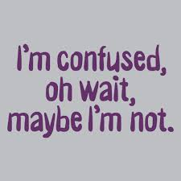
There is no such thing as a Maths person. Everyone can become a better learner in Maths
What strategies could you use when you get stuck?

Slide 11
Class Strategies for getting ourselves unstuck….
Notes:
Record the classes strategies on the board.

Slide 12
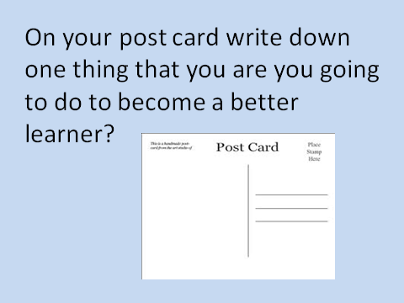
In this class….
We can all be successful
We can all learn from one another
We will all choose tasks that challenge us
We all have different starting points
We can all make progress
The best students are the students who make the most progress

Slide 13
On your post card write down one thing that you are you going to do to become a better learner?

Slide 14
