Slide 1
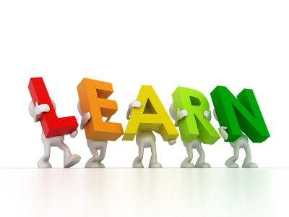
In this class…… We all have different starting points. We can all learn from one another. We can all make progress. We will value our mistakes because we can learn from them. We will choose tasks that challenge us because this is how we develop our skills and understanding. We will keep trying even when we are finding a task difficult because this is how we make progress.

Slide 2
In this class…… We all have different starting points. We can all learn from one another. We can all make progress. We will value our mistakes because we can learn from them. We will choose tasks that challenge us because this is how we develop our skills and understanding. We will keep trying even when we are finding a task difficult because this is how we make progress.

