Slide 1
LO To assess my understanding of inequalities | RAG
Key Words: Integer, Represent, Variable, Satisfy | 27/04/2014
Grade | D | C | B | A
Inequalities | I can find all the possible integer values for an inequality. I can write down an inequality represented in a diagram. I can represent an inequality on a number line. | I can solve linear inequalities and represent the solution on a number line. | I can represent a region that satisfies one or more linear inequalities graphically. | I can use inequalities to describe practical situations and find possible solutions. I can solve quadratic inequalities.

Slide 2
Grade D
–3 < n < 4 n is an integer. Write down all the possible values of n. | Solve the inequality 3p−7 > 11
Write down the inequality shown in the diagram. | –2 < n ≤ 3 Represent this inequality on the number line.
Notes:
Print slides 2 -5 two slides to a page.

Slide 3
Grade C
I am thinking of a number, multiplying it by 5 then adding 3. The answer is greater than or equal to 43 and less than or equal to 48. What could it be? | Solve the inequality 7x – 9 < 3x + 4
 | Solve the inequality 8x – 3 ≥ 6x + 4
Solve the inequality x +5 < 3x – 1 < 2x + 11

Slide 4
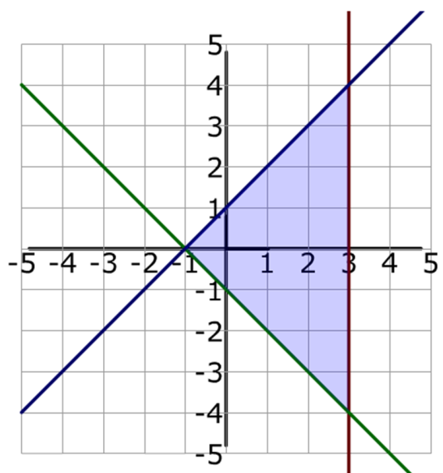
Grade B
On the grid below draw straight lines and use shading to show the region that satisfies the inequalities | Write down the 3 inequalities which describe the shaded region.

Slide 5
Grade A
Question An 18-wheel truck stops at a weigh station before passing over a bridge. The weight limit on the bridge is 65,000 pounds. The cab (front) of the truck weighs 20,000 pounds, and the trailer (back) of the truck weighs 12,000 pounds when empty. In pounds, how much cargo can the truck carry and still be allowed to cross the bridge? Represent this situation as an inequality and solve. | Working Out & Answer
Solve the inequality to 1 decimal place.

Slide 6
Grade | D | C | B | A
Inequalities | I can find all the possible integer values for an inequality. I can write down an inequality represented in a diagram. I can represent an inequality on a number line. | I can solve linear inequalities and represent the solution on a number line. | I can represent a region that satisfies one or more linear inequalities graphically. | I can use inequalities to describe practical situations and find possible solutions. I can solve quadratic inequalities.
Notes:
Print slides 6 & 7 two slides to a page.

Slide 7
My teachers probing question | My answer
What I will do to act upon my ‘Even Better If’’ comment
Strategy |  | Tick / Comments
Complete a mymaths lesson or booster pack
Use a revision guide or text book
Ask my teacher to explain during a lesson
Ask a peer to explain during a lesson
Ask someone at home to help
Attend a revision session at school
Attend homework club
Something else (describe your strategy here)
Notes:
Dialogue marking sheet.

