Slide 1
LO To assess my understanding of area and perimeter | RAG
Key Words: Reflect, Communicate, Explain, Justify | 12/10/2014
Starter Activity
Complete the ‘Heard the Word Grid.’
Are there any key words that you have learnt or have a better understanding of now than you did at the start of this unit of work?

Slide 2
Grade | G | F | E | D | C
Area & Perimeter | I can find the area of a 2-D shape by counting squares. I can find the perimeter of a 2-D shape. I know the words ‘radius’, ‘diameter’, ‘circumference.’ | I can find the area of a rectangle using the formula. | I can find the area of a triangle using the formula. I can find the area of a compound shape. | I can calculate the area of a trapezium. I can calculate the area and circumference of a circle. | I can find the area of a semi circle.

Slide 3
Key Words / symbols | Never heard before? | Heard of but not sure what it means? | Know what it means and can explain it in context Jot down your ideas here...
Perimeter
Area
Circumference
Diameter
Radius
Pi
Notes:
Print slides 3-10 two slides to a page.

Slide 4
Grade G Questions | Answers & Working 0ut
Find the area and the perimeter of the shaded shape. | Area = Perimeter =
The diagram shows a rectangle and a square. ? The perimeter of the rectangle is the same as the perimeter of the square. Work out the perimeter of the rectangle. Work out the length of one side of the square. | Perimeter of rectangle = Length of side of square =
8cm
2cm
Notes:
Print slides 3-8 two slides to a page.

Slide 5
Grade F Questions | Answer & Working 0ut
Dilys buys a new house. She wants to have a lawn in the back garden. The lawn is going to be in the shape of the rectangle shown. A box of grass seed will generate 30m² of lawn. How many boxes does Dilys need to buy?
Grade E Question | Answer & Working 0ut
Work out the area of the shape below. (Diagram not accurately drawn.)
10m
8m
Notes:
Print slides 2-10 two slides to a page.

Slide 6
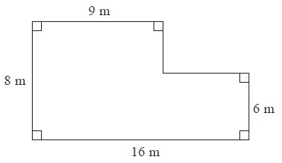
Grade E Question | Answer & Working 0ut
The diagram shows the floor plan of Jill's dining room. Jill is going to cover the floor with wooden floorboards. The floorboards are sold in packs. One pack of floorboards will cover 2.25 m². Work out how many packs Jill needs. You must show all your working.
Notes:
Print slides 2-10 two slides to a page.

Slide 7
Grade D Questions | Answers & Working 0ut
Work out the Area and the Circumference of this circle, which has a diameter of 12 cm. (Diagram not accurately drawn.) | Area = Circumference =
Find the area of the trapezium. (Diagram not accurately drawn.)
Notes:
Print slides 3-8 two slides to a page.

Slide 8
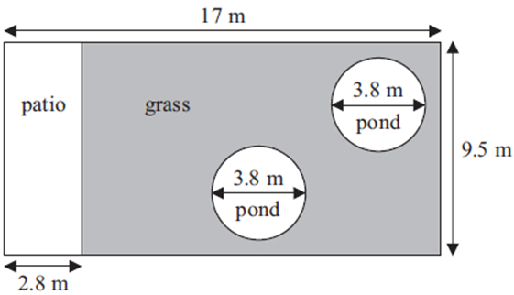
Grade D Questions | Answers & Working 0ut
Mr Weaver's garden is in the shape of a rectangle. In the garden there is a patio in the shape of a rectangle and two ponds in the shape of circles with diameter 3.8 m. The rest of the garden is grass. Mr Weaver is going to spread fertiliser over all the grass. One box of fertiliser will cover 25 m² of grass. How many boxes of fertiliser does Mr Weaver need? Show all your working out.
Notes:
Print slides 2-10 two slides to a page.

Slide 9
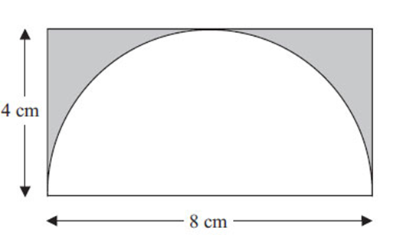
Grade C Questions | Answers & Working 0ut
The diagram shows a semicircle drawn inside a rectangle. (Diagram not accurately drawn.) The semicircle has a diameter of 8 cm. The rectangle is 8 cm by 4 cm. Work out the area of the shaded region. Give your answer correct to 3 significant figures.
Notes:
Print slides 3-10 two slides to a page.

Slide 10
Use the space below to set yourself a question similar to the ones you were able to answer confidently. | Use the space below to answer the question that you have set yourself
My own question… | My answer…
My own question… | My answer…

Slide 11
Grade | G | F | E | D | C
Area & Perimeter | I can find the area of a 2-D shape by counting squares. I can find the perimeter of a 2-D shape. I know the words ‘radius’, ‘diameter’, ‘circumference.’ | I can find the area of a rectangle using the formula. | I can find the area of a triangle using the formula. I can find the area of a compound shape. | I can calculate the area of a trapezium. I can calculate the area and circumference of a circle. | I can find the area of a semi circle.
Use the learning journey above to highlight the mathematical skills that you have now which you didn’t have at the start of the unit of work.
How much progress have you made?
What can you do to improve your skills as a learner in order to make even better progress?
Notes:
Dialogue marking sheet.

Slide 12
My teachers probing question | My answer
What I will do to act upon my ‘Even Better If’’ comment
Strategy |  | Tick / Comments
Complete a mymaths lesson or booster pack
Use a revision guide or text book
Ask my teacher to explain during a lesson
Ask a peer to explain during a lesson
Ask someone at home to help
Attend a revision session at school
Attend homework club
Something else (describe your strategy here)
Notes:
Dialogue marking sheet.

