Slide 1
LO To assess my understanding of Algebraic Fractions and Changing the Subject of a Formula. | RAG
Key Words: Reflect, Communicate, Explain, Justify | 12/10/2014
Starter Activity
Complete the ‘Heard the Word Grid.’
Are there any key words that you have learnt or have a better understanding of now than you did at the start of this unit of work?

Slide 2
Grade | D | C | B | A | A*
Algebraic Fractions and Changing the Subject of a Formula | Solve linear equations where the variable occurs in the numerator of a fraction. | I can rearrange simple formulae. | I can rearrange more complicated formulae. | I can combine algebraic fractions using the four rules of addition, subtraction, multiplication & division. I can rearrange a formula where the subject appears twice. | I can simplify algebraic fractions by factorisation and cancellation. I can rearrange more complicated formulae where the subject may appear twice or as a power. I can solve a quadratic equation obtained from manipulating algebraic fractions where the variable appears in the denominator.

Slide 3
Key Words / symbols | Never heard before? | Heard of but not sure what it means? | Know what it means and can explain it in context Jot down your ideas here...
Cancellation
Factorisation
Solve
Rearrange
Variable
Make the Subject of the formula
Notes:
Print slides 3-10 two slides to a page.

Slide 4
Grade D Questions
Solve this Equation | Solve this Equation
Solve this Equation | How do you decide where to start when solving a linear equation where the unknown number appears in the numerator of a fraction ?
x
3x + 2
+ 5 = 8
= 5
7
4
3x + 7
= 2
11
Notes:
Print slides 2-10 two slides to a page.

Slide 5
Grade C Questions
Make t the subject of the formula v = u + 5t | Make c the subject of the formula a = 3c – 4
Make y the subject of the formula x = 3y + 2 | What are the similarities and differences between rearranging a formula and solving an equation?
Notes:
Print slides 2-10 two slides to a page.

Slide 6
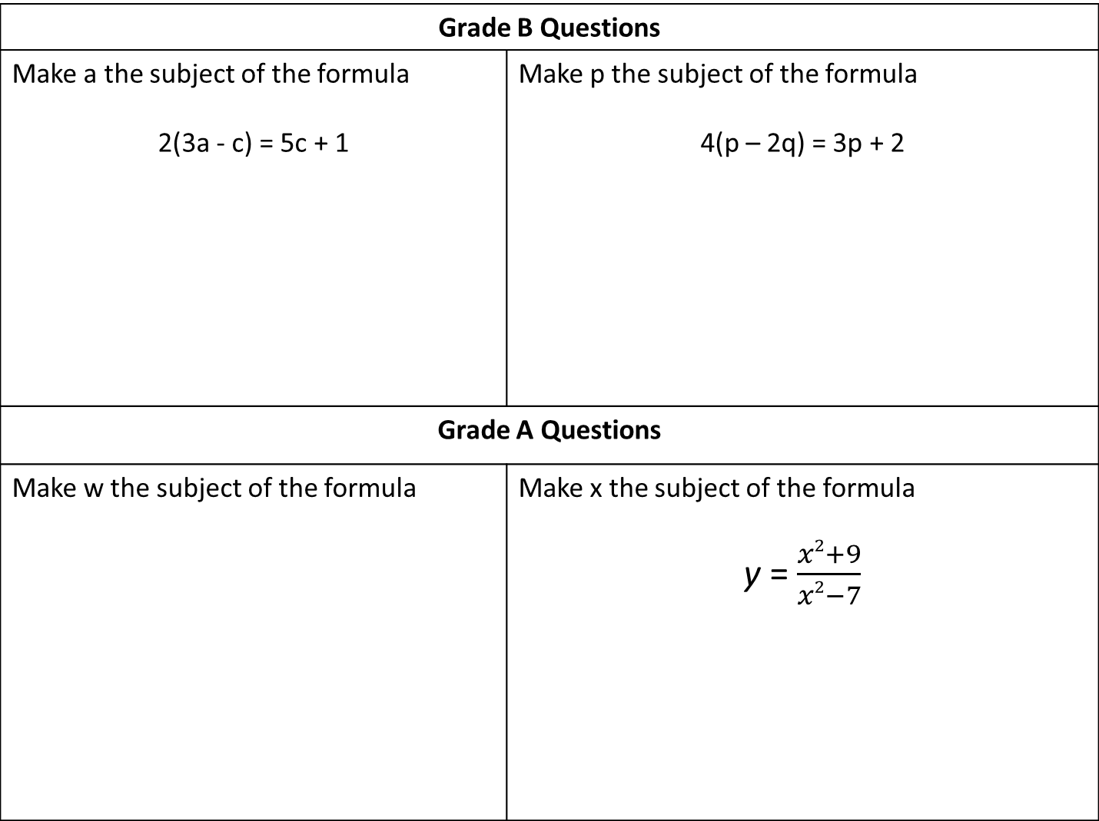
Grade B Questions
Make a the subject of the formula 2(3a - c) = 5c + 1 | Make p the subject of the formula 4(p – 2q) = 3p + 2
Grade A Questions
Make w the subject of the formula | Make x the subject of the formula y = $\frac{x2+9}{x2−7}$
S = 2lw + 2lh + 2hw
Notes:
Print slides 2-10 two slides to a page.

Slide 7
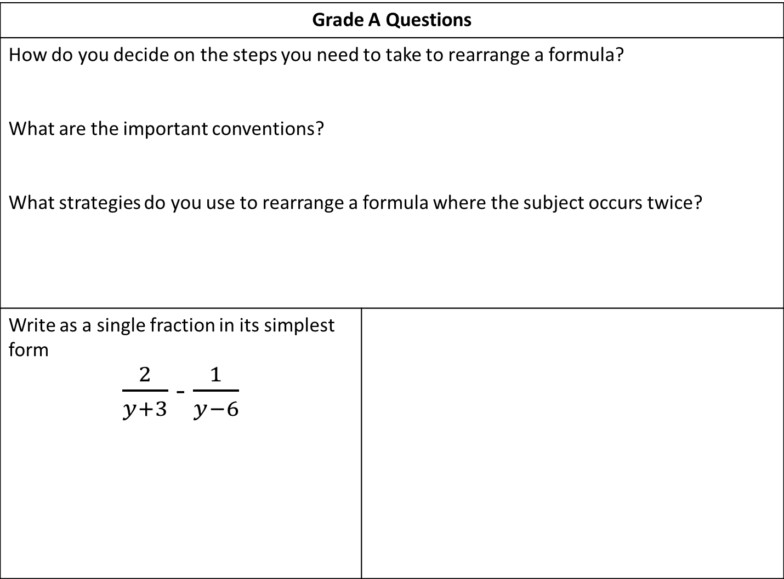
Grade A Questions
How do you decide on the steps you need to take to rearrange a formula? What are the important conventions? What strategies do you use to rearrange a formula where the subject occurs twice?
Write as a single fraction in its simplest form $\frac{2}{y+3}$ - $\frac{1}{y−6}$
Notes:
Print slides 2-10 two slides to a page.

Slide 8
Grade A* Questions
Simplify Fully | Simplify Fully
Solve
4
3
x
2
–
= 1
Solve
+
= 3
x + 2
x + 8
4 – x
x
Notes:
Print slides 2-10 two slides to a page.

Slide 9
Use the space below to set yourself a question similar to the ones you were able to answer confidently. | Use the space below to answer the question that you have set yourself
My own question… | My answer…
My own question… | My answer…

Slide 10
Grade | D | C | B | A | A*
Algebraic Fractions and Changing the Subject of a Formula | Solve linear equations where the variable occurs in the numerator of a fraction. | I can rearrange simple formulae. | I can rearrange more complicated formulae. | I can combine algebraic fractions using the four rules of addition, subtraction, multiplication & division. I can rearrange a formula where the subject appears twice. | I can simplify algebraic fractions by factorisation and cancellation. I can rearrange more complicated formulae where the subject may appear twice or as a power. I can solve a quadratic equation obtained from manipulating algebraic fractions where the variable appears in the denominator.
Use the learning journey above to highlight the mathematical skills that you have now which you didn’t have at the start of the unit of work.
How much progress have you made?
What can you do to improve your skills as a learner in order to make even better progress?
Notes:
Dialogue marking sheet.

Slide 11
My teachers probing question | My answer
What I will do to act upon my ‘Even Better If’’ comment
Strategy |  | Tick / Comments
Complete a mymaths lesson or booster pack
Use a revision guide or text book
Ask my teacher to explain during a lesson
Ask a peer to explain during a lesson
Ask someone at home to help
Attend a revision session at school
Attend homework club
Something else (describe your strategy here)
Notes:
Dialogue marking sheet.

