Slide 1
LO To assess my understanding of the solving equations | RAG
Key Words: Reflect, Communicate, Explain, Justify | 19/10/2014
Starter Activity
Complete the ‘Heard the Word Grid.’
Are there any key words that you have learnt or have a better understanding of now than you did at the start of this unit of work?

Slide 2
Key Words / Methods | Never heard before? | Heard of but not sure what it means? | Know what it means and can explain it in context Jot down your ideas here...
Term
Equation
Solve
Expand
Factorise
Substitute
Inverse Operation

Slide 3
Grade | E | D | C | B | A/A*
Solving Equations | I can solve simple equations with unknowns on one side, for example 3x + 2 = 7 | I can solve linear equations with unknowns on both sides of the equals sign. I can solve linear equations where the unknown occurs in the numerator of a fraction. | I can solve equations using trial and improvement. | I can solve two simultaneous linear equations. I can solve a quadratic equation of the form x² + bx + c = 0 I can solve linear equations involving algebraic fractions where the subject appears as the numerator. | I can set up and solve two simultaneous equations from a practical problem. I can solve a quadratic equation of the form ax² + bx + c = 0 I can solve a pair of simultaneous equations where one is linear and the other is non-linear (A*)

Slide 4
Grade E Questions
Solve e + e + e + e + e = 45 How can you check that your answer is correct? | Solve 18 − x = 13 Give me another equation with the same solution.
Solve 7c = 28 How can you check that your answer is correct? | Solve 2(y − 5) = 24 How did you decide where to start?

Slide 5
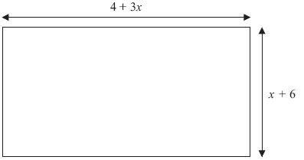
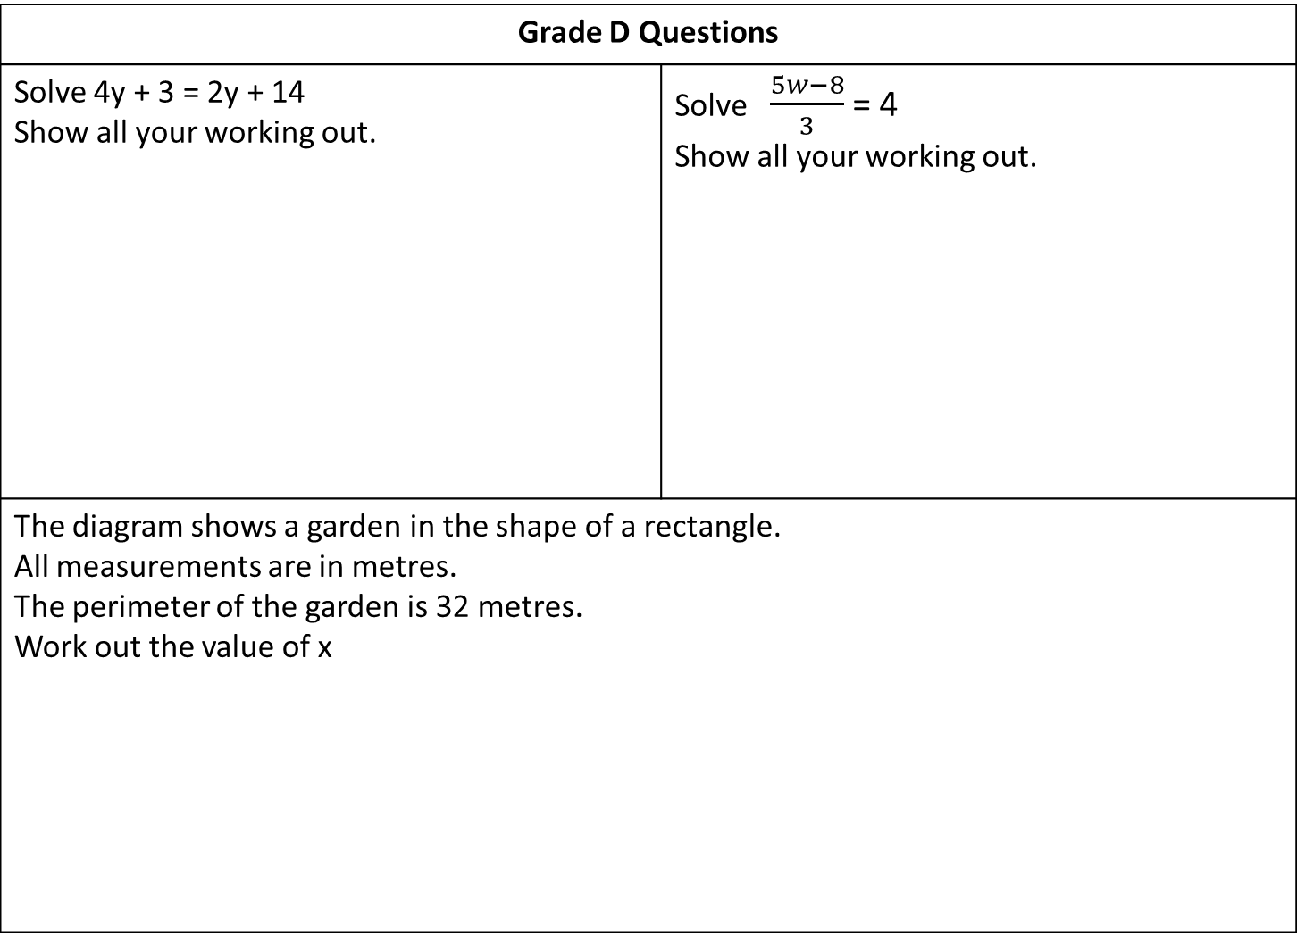
Grade D Questions
Solve 4y + 3 = 2y + 14 Show all your working out. | Solve $\frac{5w−8}{3}$ = 4 Show all your working out.
The diagram shows a garden in the shape of a rectangle. All measurements are in metres. The perimeter of the garden is 32 metres. Work out the value of x

Slide 6
Grade C Questions
The equation x³ + 2x = 110 has a solution between 4 and 5 Use a trial and improvement method to find this solution. Give your answer correct to one decimal place. You must show ALL your working.

Slide 7
Grade B Questions
Solve the simultaneous equations Show all your working out. 5x + 2y = 11 4x – 3y = 18 | Solve Show all your working out.
Solve the equation: x² - 9x + 20 = 0 Show all your working out. | Solve the equation x² + 6x = 2 How is solving this equation different from solving the last equation?

Slide 8
Grade A/A* Questions
Solve the simultaneous equations x² + y² = 25 y = 2x + 5 | Solve, by factorising, the equation 8x² − 30x − 27 = 0
The cost of theatre tickets for 4 adults and 3 children is £47.50.
The cost for 2 adults and 6 children is £44.
How much does each adult and child ticket cost?

Slide 9
Use the space below to set yourself a question similar to the ones you were able to answer confidently. | Use the space below to answer the question that you have set yourself
My own question… | My answer…
My own question… | My answer…

Slide 10
Grade | E | D | C | B | A/A*
Solving Equations | I can solve simple equations with unknowns on one side, for example 3x + 2 = 7 | I can solve linear equations with unknowns on both sides of the equals sign. I can solve linear equations where the unknown occurs in the numerator of a fraction. | I can solve equations using trial and improvement. | I can solve two simultaneous linear equations. I can solve a quadratic equation of the form x² + bx + c = 0 I can solve linear equations involving algebraic fractions where the subject appears as the numerator. | I can set up and solve two simultaneous equations from a practical problem. I can solve a quadratic equation of the form ax² + bx + c = 0 I can solve a pair of simultaneous equations where one is linear and the other is non-linear (A*)
Use the learning journey above to highlight the mathematical skills that you have now which you didn’t have at the start of the unit of work.
How much progress have you made?
What can you do to improve your skills as a learner in order to make even better progress?

Slide 11
My teachers probing question | My answer
What I will do to act upon my ‘Even Better If’’ comment
Strategy |  | Tick / Comments
Complete a mymaths lesson or booster pack
Use a revision guide or text book
Ask my teacher to explain during a lesson
Ask a peer to explain during a lesson
Ask someone at home to help
Attend a revision session at school
Attend homework club
Something else (describe your strategy here)
Notes:
Dialogue marking sheet.

