Slide 1
Lesson Plan
The BIG picture?
Stickability!
To develop the reasoning skills of our pupils through Inquiry.
Objectives
Engagement?
Asking questions moves learning on more that answering questions.
Pupils have ownership of the their learning.
To deepen pupils’
understanding of
finding fractions of
an amount.
To develop our pupils’
skills as
independent learners.
Differentiation
A f L
Finding unit fractions of an amount.
Finding improper fractions of an amount.
Making generalisations about fractions.
Learning Journey
Spotting the mistake Feedback questions
Class discussion
Denominator, Numerator, Equivalence. Justify, Communicate, Procedure, Method
Learning Episodes
Pupils work in pairs to make a statement or pose a question about the prompt. These are then shared in a class discussion.
Pupils to choose their next steps by finding more examples, changing the prompt or choosing one of the alternative tasks.
Pupils to feedback their views about the Inquiry and if / how participation in the Inquiry moved their learning on.
Pupils to identify and correct the common mistakes.

Slide 2
$\frac{4}{10}$ of 70 = $\frac{7}{10}$ of 40
LO To develop my skills as an Independent Learner by taking part in an Inquiry | RAG
Key Words: Concept, process, communicate, evaluate | 24-Mar-14
Starter Activity
In your pairs write down a questions or thought about the statement on your whiteboards. You can use the sentence starters provided to help you.

Slide 3
Sentence Starters
Posing a question | Sharing a thought
What does …………..mean? Is it right that…….? How is it true that ……….? Why is……? Would it be …….if…….? | We notice that ………… We know that ……because…. We think that…….because….. We wonder whether ….. We can change ………
Notes:
Pupils will have this as a hand out to refer to.

Slide 4
Sentence Starters
Posing a question | Sharing a thought
What does …………..mean? Is it right that…….? How is it true that ……….? Why is……? Would it be …….if…….? | We notice that ………… We know that ……because…. We think that…….because….. We wonder whether ….. We can change ………
Notes:
Pupils will have this as a hand out to refer to.

Slide 5
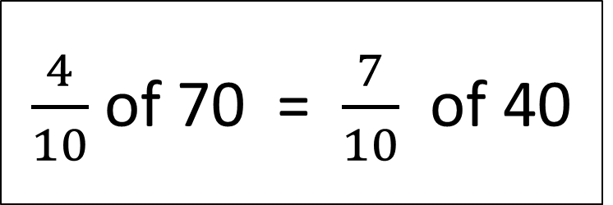
$\frac{4}{10}$ of 70 = $\frac{7}{10}$ of 40

Slide 6
How to use the ‘next step’ and ‘how to work’ suggestions.
Remember in an Inquiry lesson you decide what your aim is and how you are going to achieve it.
You must take responsibility for your own learning and ensure that you are always on task.
You can refer to the ‘next step’ and ‘how to work’ suggestions at any point during the lesson.

Slide 7
Choosing a next step
Ask the teacher for guidance to find some more examples. (Resource A) | Try to find some more examples. | Decide if the prompt Is true.
Prove the prompt is always true. | Ask the teacher for an exercise to practice finding unit fractions of an amount e.g. ⅓ ⅕ ⅙ ⅛ (Resource C) | Ask the teacher for an exercise to consolidate your understanding of fractions of an amount. (Resource D)
Ask the teacher for guidance to change the prompt. (Resource B) | Change the Prompt | Decide what the problem is.
Notes:
Pupils will have this as a hand out to refer to.

Slide 8
Choosing how to work.
Share our results. | Work on the problem alone. | Discuss as a class.
Work with another students. | Ask a student to explain. | Ask the teacher to explain.
Share our ideas. | Look back at what we’ve done. | Discuss with my neighbour.
Notes:
Pupils will have this as a hand out to refer to.

Slide 9
I need an explanation of how to find a fraction of an amount.
Notes:
Ask pupils to indicate if they need an explanation by placing this card face up on their desk.

Slide 10
I can explain how to find a fraction of an amount.
Notes:
Ask pupils to indicate if they can provide an explanation by placing this card face up on their desk.

Slide 11
Resource A Come up with some of your own examples. Here are some to get you started:
$\frac{6}{10}$ of 80 = $\frac{8}{10 }$ of ….
$\frac{3}{5}$ of 40 = $\frac{4}{5 }$ of ….
$\frac{4}{5}$ of 20 = $\frac{}{5 }$ of 40
$\frac{5}{6}$ of 30 = of …..

Slide 12
$\frac{3}{7}$ of 56 = $\frac{56}{7}$ of 3
Resource B
You change the prompt by using top heavy fractions.
Notes:
Print 2 to a page.

Slide 13
Resource B Here is an alternative prompt, decide if it is always true, sometimes true or never true.
Finding a fraction of something makes it smaller
Notes:
Print 2 to a page.

Slide 14



Resource C Complete the spider diagram to practice finding unit fractions of an amount.
60
$$\frac{1}{6}$$
1/6
$$\frac{1}{3}$$
1/3
$$\frac{1}{5}$$
1/5
$$\frac{1}{4}$$
1/4
1/6
1/3
$$\frac{1}{12}$$
$$\frac{1}{30}$$
$$\frac{1}{10}$$

Slide 15
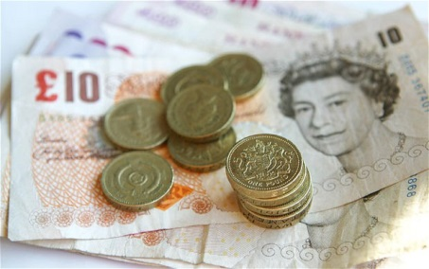
Resource D – Alternative Task
Task One - I’d Rather Have…..
For each question, select whether you would choose Option A or Option B. You must give a reason for your answer.
Option A Option B
¼ of £100 or 1/5 of £135
1/7 of £210 or 1/6 of £240
2/5 of £300 or 3/7 of £273
5/7 of £420 or 8/11 of £132
9/12 of £504 or 15/20 of £500
7/8 of £280 or 9/10 of £270
7/2 of £10 or 9/4 of £20
56/7 of £200 or 96/8 of £130
What is the maximum amount of money you could get from your choices?
What is the least amount of money you could get from your choices?
Notes:
Print 2 to a page.

Slide 16
Task Two – What’s the missing number…..
Fill in the missing numbers in each box to make each statement true
Notes:
Print 2 to a page.

Slide 17
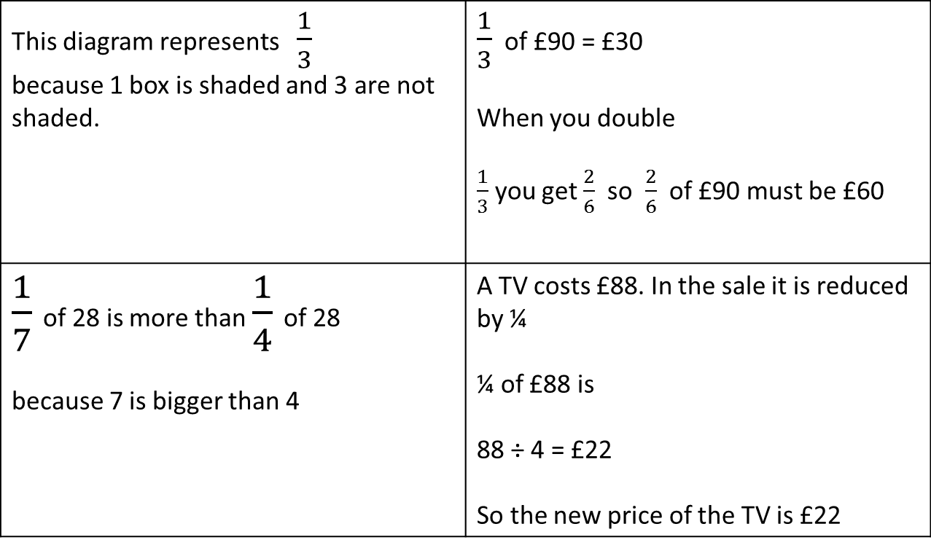
Plenary – Spot the mistake and correct it
This diagram represents $\frac{1}{3}$ because 1 box is shaded and 3 are not shaded. | $\frac{1}{3}$ of £90 = £30 When you double $\frac{1}{3}$ you get $\frac{2}{6}$ so $\frac{2}{6}$ of £90 must be £60
$\frac{1}{7}$ of 28 is more than $\frac{1}{4}$ of 28 because 7 is bigger than 4 | A TV costs £88. In the sale it is reduced by ¼ ¼ of £88 is 88 ÷ 4 = £22 So the new price of the TV is £22

Slide 18
Inquiry | Dependent Independent
Posing Questions , Making Statements and Regulating the Inquiry | I can ask what the prompt means. I can collaborate with another pupil to chose a ‘next step’. I can accept the aims set by the teacher. I can work in a group. I can describe the Inquiry in basic mathematical terms. | I can show whether the prompt is true or false. I can choose a ‘next step’ which will move the Inquiry on. I can explain the aims set by the teacher. I can work as part of a group. I can explain the Inquiry in mathematical terms. | I can comment on what I have noticed about the prompt. I can explain my choice of ‘next step’. I can negotiate the aims of the Inquiry with the teacher and peers. I can contribute to the decisions made by the group. I can analyse and explain the Inquiry using mathematical terms. | I can generalise and develop a theory. I can change the prompt. I can reflect on the development of the Inquiry. I can decide what to do and plan multiple ‘next steps’. I can set my own aims. I can reflect upon the effectiveness of my decisions and change direction when necessary. I can evaluate the Inquiry using specific mathematical terms.

Slide 19
Inquiry | Dependent Independent
Using and Applying Mathematical Concepts and Procedures | I understand how a familiar mathematical concept is applied to the Inquiry. I can use a familiar procedure to generate more examples. I understand a general statement about the prompt. I can describe a theory. | I can explain why a new mathematical concept is required to make progress in the Inquiry. I can explain why a new procedure is required to make progress in the Inquiry. I can explain a theory. I can provide an example to either prove or disprove the theory. | I recognise the links between the mathematical concepts used in the Inquiry. I have attempted to apply a new mathematical concept to the Inquiry. I can explain why a new mathematical procedure is relevant to Inquiry. I have attempted to apply a new mathematical procedure to the Inquiry. I can analyse a theory, giving reasons why it might be true or false and describe how this can be proved. | I can seek out a new mathematical concept, apply it and evaluate how it moved the Inquiry on. I can seek out a new mathematical procedure, apply it and evaluate how it moved the Inquiry on. I can prove whether a theory is true or false using mathematical reasoning with diagrams or algebra.

