Slide 2
Our greatest weakness lies in giving up. The most certain way to success is always to try just one more time.
Thomas Edison

Slide 3
“The passion for stretching yourself and sticking to it , even (or especially) when it’s not going well is the hallmark of the growth mindset. This is the mindset that allows people to thrive during some of the most challenging times in their lives.”
Carole S Dweck

Slide 4
‘There is a difference between not knowing and not knowing yet.’
Sheila Tobias

Slide 5
A teacher’s job is not to make work easy. It is to make it difficult. If you are not challenged, you do not make mistakes. If you do not make mistakes, feedback is useless.
John Hattie

Slide 6
Sometimes what we call
“failure”
is really just that necessary struggle called learning.

Slide 7
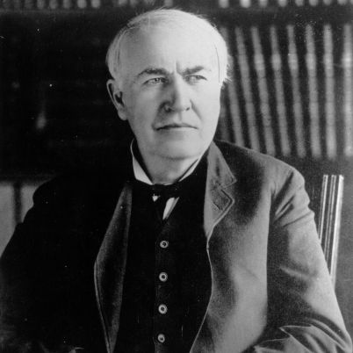
‘You must learn to fail intelligently. Failing is one of the greatest arts in the world. One fails forward towards success.’
Thomas Edison
Notes:
Explain that growth mindset is much more than a ‘can do’ attitude, it is about what pupils do when faced with what they perceive to be failure.

Slide 8
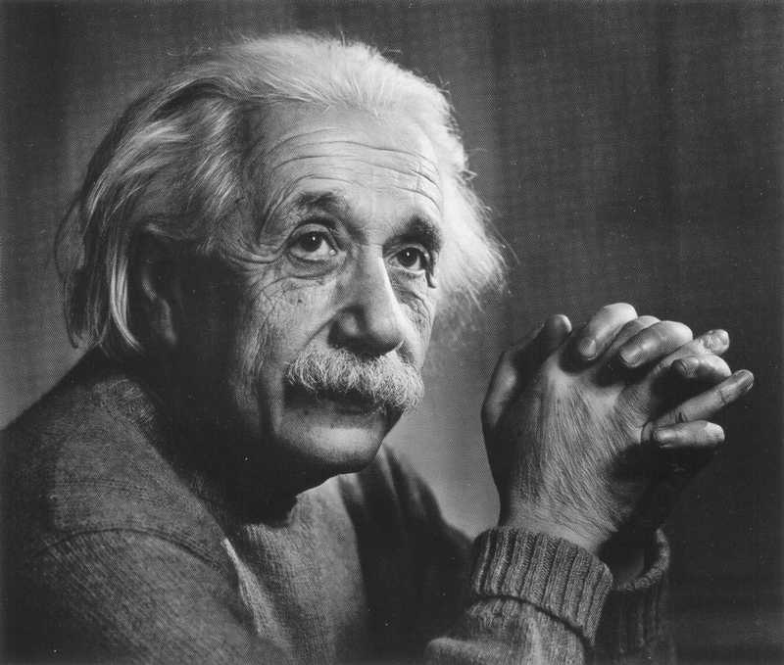
‘I think and think for months and years. Ninety nine times out of a hundred I am wrong. The hundredth time I am right.’
Albert Einstein

Slide 9
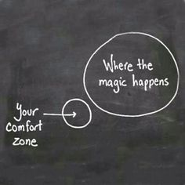

Slide 10
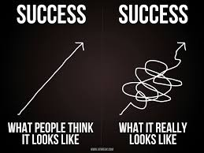

Slide 11
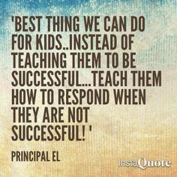

Slide 12
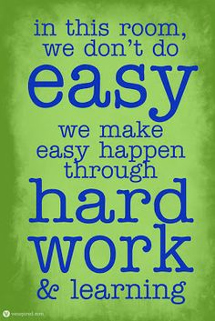
Notes:
Discuss the importance of changing the culture of learning with reference to PACA

Slide 13
