Slide 1
LO To assess my understanding of Probability | RAG
Key Words: Reflect, Communicate, Explain, Justify | 15/11/2014
Starter Activity
Complete the ‘Heard the Word Grid.’
Are there any key words that you have learnt or have a better understanding of now than you did at the start of this unit of work?

Slide 2
Key Words / Methods | Never heard before? | Heard of but not sure what it means? | Know what it means and can explain it in context Jot down your ideas here...
Event
Outcome
Biased
Relative Frequency
Sample Space Diagram
Probability Tree
Combined Events

Slide 3
Grade | D | C | B | A/A*
Probability | I can calculate a probability of an event happening if I know the probability of all other events. I can calculate the expected number of successes from x trials if I know the probability of successes. I can write the probability of an event happening I know and can use the word OR in probability. | I can calculate probability from relative frequency. I can compare this with theoretical probability. I can complete a sample space diagram listing all probabilities. | I can draw and use tree diagrams to work out probabilities of combined events. I know how to use the words OR AND in probability. | I can use and / or / tree diagrams to work out probabilities of specific outcomes of combined events. I can use and / or / tree diagrams to work out probabilities of specific outcomes of combined events when the probability of the event changes depending on the previous outcome (without replacement).

Slide 4
Grade D
There are only red counters, blue counters, white counters and black counters in a bag. The table shows the probability that a counter taken at random from the bag will be red or blue. Work out the probability that Tania takes either a red counter or a blue counter. The number of white counters in the bag is the same as the number of black counters in the bag. Tania takes at random a counter from the bag. Work out the probability that Tania takes a white counter. There are 240 counters in the bag. Work out the number of red counters in the bag.
Colour | Red | Blue | White | Black
Probability | 0.2 | 0.5

Slide 5
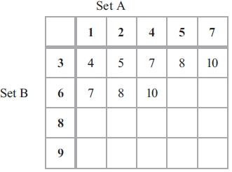
Grade C
Josh plays a game with two sets of cards.
Josh takes at random one card from each set.
He adds the numbers on the two cards to get the total score.
Complete the table to show all the
possible total scores.
What is the probability that Josh's total score will be greater than 12?
Josh's year group are raising money for a sponsored skydive.
60 students are each going to play Josh's card game once.
Each student pays 50p to play the game.
Josh pays £1.50 to any player getting a total of 8
Show that Josh can expect to make a profit of £21 from his game.

Slide 6
Grade C
Lorna carries out a survey about the number of times customers go to a shop. She asks at random 100 customers how many times they went to the shop last month. The table shows Lorna's results. One of the 100 customers is chosen at random. What is the probability that this customer went to the shop 5 or more times? Last month the shop had a total of 1500 customers. Work out an estimate for the number of customers who went to the shop exactly 2 times last month.

Slide 7
Grade C
Carolyn has 20 biscuits in a tin. She has 12 plain biscuits 5 chocolate biscuits 3 ginger biscuits Carolyn takes at random two biscuits from the tin. Work out the probability that the two biscuits were not the same type.

Slide 8
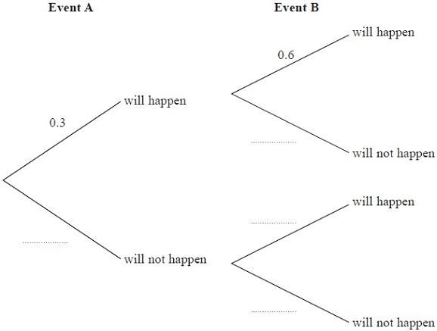
Grade B
Event A and event B are independent events.
The probability that event A will happen is 0.3
The probability that event B will happen is 0.6
Work out the probability that either event A will happen or event B will happen but not both.

Slide 9
Grade B
Clive wants to estimate the number of bees in a beehive. Clive catches 50 bees from the beehive. He marks each bee with a dye. He then lets the bees go. The next day, Clive catches 40 bees from the beehive. 8 of these bees have been marked with the dye. Work out an estimate for the number of bees in the beehive.

Slide 10
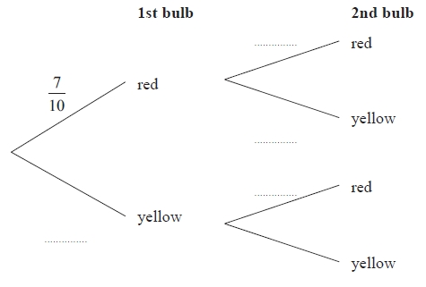
Grade A
Yvonne has 10 tulip bulbs in a bag.
7 of the tulip bulbs will grow into red tulips.
3 of the tulip bulbs will grow into yellow tulips.
Yvonne takes at random two tulip bulbs from the bag.
She plants the bulbs.
Complete the probability tree diagram.
Work out the probability that at least one of the bulbs will grow into a yellow tulip..

Slide 11
Grade A
There are ten pens in a box. 4 of the pens are red. 6 of the pens are black. Josh takes at random a pen from the box. He puts the pen into his bag. He then takes at random another pen from the box. Work out the probability that Josh takes one pen of each colour.

Slide 12
Use the space below to set yourself a question similar to the ones you were able to answer confidently. | Use the space below to answer the question that you have set yourself
My own question… | My answer…
My own question… | My answer…

Slide 13
Grade | D | C | B | A/A*
Probability | I can calculate a probability of an event happening if I know the probability of all other events. I can calculate the expected number of successes from x trials if I know the probability of successes. I can write the probability of an event happening I know and can use the word OR in probability. | I can calculate probability from relative frequency. I can compare this with theoretical probability. I can complete a sample space diagram listing all probabilities. | I can draw and use tree diagrams to work out probabilities of combined events. I know how to use the words OR AND in probability. | I can use and / or / tree diagrams to work out probabilities of specific outcomes of combined events. I can use and / or / tree diagrams to work out probabilities of specific outcomes of combined events when the probability of the event changes depending on the previous outcome (without replacement).
Use the learning journey above to highlight the mathematical skills that you have now which you didn’t have at the start of the unit of work.
How much progress have you made?
What can you do to improve your skills as a learner in order to make even better progress?

Slide 14
My teachers probing question | My answer
What I will do to act upon my ‘Even Better If’’ comment
Strategy |  | Tick / Comments
Complete a mymaths lesson or booster pack
Use a revision guide or text book
Ask my teacher to explain during a lesson
Ask a peer to explain during a lesson
Ask someone at home to help
Attend a revision session at school
Attend homework club
Something else (describe your strategy here)
Notes:
Dialogue marking sheet.

