Slide 1
Learning Objective: To assess my understanding of solving equations.
RAG
Key Words: Reflect, Communicate, Explain, Justify
15-Mar-14
Starter Activity
Complete the ‘Heard the Word Grid’ and compare it to the one you completed at the start of this unit of work.
Are there any key words that you have learnt or have a better understanding of than you did before?
Notes:
1

Slide 2
Key Words | Never heard before? | Heard of but not sure what it means? | Know what it means and can explain it in context Jot down your ideas here...
Equation
Expression
Formula
Substitute
Term
Solve
Unknown

Slide 3
Level | 3 | 4 | 5 | 6 | 7/8
Algebra | I am beginning to understand the role of the = sign | I can find missing numbers. I can match a formula expressed in words to a calculation. | I can solve linear equations with unknowns on one side including negative numbers. I can match a formula expressed in words to an algebraic expression. | I can solve linear equations with unknowns on both sides including with negative numbers and brackets. I can construct and solve linear equations | I can construct and solve simultaneous equations.

Slide 4
Level | Question | Answer
3c | True or false 12 + 8 = 6 + 14 How do you know?
3b | True or false 12 – 5 = 5 – 12 How do you know?

Slide 5
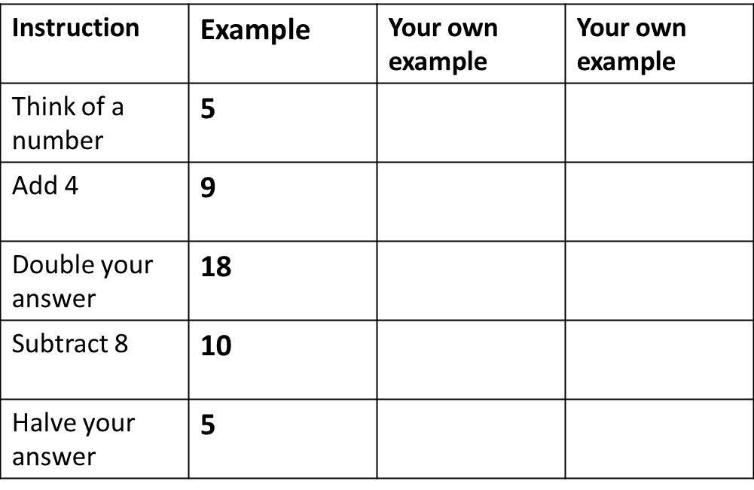
Level | Here are the instructions for a puzzle. Fill in the table. Complete this sentence. The final number in the puzzle will always be …………………………………… ……………………………………
3a
My own level 3 question and answer. | Question | Answer

Slide 6
Level | Write one number at the end of each equation to make it correct. Example 26 + 34 = 16 + 44 400 + 150 = 500 + .................. 14 + 6 = 4 + .................. (c) 37 – 20 = 27 – ..................
4c
4b
Look at this equation.
4 + a = b
Write a pair of numbers for a and b to make the equation true.
a = …………………………..
b = ……………………………

Slide 7
Level
4a
My own level 4 question and answer | Question | Answer
The equation shows how much you
pay to hire a car.
N X 20 = T
N Stands for the number of days.
T stands for the total you pay in £
Leena hires the car for 6 days. How much does she pay?
Jack pays £180 to hire a car. How many days did he hire the car for?

Slide 8
Level | Question | Answer
5c | Show me the steps that you would take to solve this equation 5c + 4 = 39 How can you check that your answer is correct.
5b | Show me the steps that you would take to solve this equation 7c – 3 = 46 How can you check that your answer is correct.

Slide 9
Level | Question | Answer
5a | Show me the steps that you would take to solve this equation 5(a + 3) = 40 How can you check that your answer is correct.
My own level 5 question and answer.

Slide 10
Level | Question | Answer
6c | Explain the method that you would use to solve the equation below 8x - 3 = 5x + 9 How can you check that your answer is correct?
6b | Explain the method that you would use to solve the equation below 5(5x – 2) = 4(3x + 6) How can you check that your answer is correct?

Slide 11
Level | Question | Answer
6a | The area of this rectangle is 27cm². Calculate the value of x and use it to find the height of the rectangle
My own level 6 question and answer.

Slide 12
Level | Question | Answer
7c | Explain the method that you would use to solve these simultaneous equations. x + 5y = 8 x + 4y = 7
7b | Explain the method that you would use to solve these simultaneous equations: 3a + 2b = 16, 5a – b = 18

Slide 13
Level | Question | Answer
7a | I think of two numbers. When I double the first one and add on the second I get 17. When I treble the first one and subtract the second one I get 18. Explain how you would work out what numbers I thought of.
My own level 7 question and answer.

Slide 14
Level 8 | Question | Answer
Question | A heating installation for the school hall consists of 5 radiators and 4 convector heaters and the cost including labour is £2080 In the sports hall 6 radiators and 7 convector heaters are used and the cost including labour is £3076. In each hall, installation costs £400. Find the cost of a radiator and the cost of a convector heater.
Answer

Slide 15
Level | 3 | 4 | 5 | 6 | 7/8
Algebra | I am beginning to understand the role of the = sign | I can find missing numbers. I can match a formula expressed in words to a calculation. | I can solve linear equations with unknowns on one side including negative numbers. I can match a formula expressed in words to an algebraic expression. | I can solve linear equations with unknowns on both sides including with negative numbers and brackets. I can construct and solve linear equations | I can construct and solve simultaneous equations.
Use the learning journey above to highlight the mathematical skills you have learnt in this unit of work.
Notes:
Dialogue marking sheet. Print slides 15-16 two to a page on coloured paper.

Slide 16
My teachers probing question | My answer
What I will do to act upon my ‘Even Better If’’ comment
Strategy | Tick / Comments
Complete a mymaths lesson or booster pack
Use a revision guide or text book
Ask my teacher to explain during a lesson
Ask a peer to explain during a lesson
Ask someone at home to help
Attend a revision session at school
Attend homework club
Something else (describe your strategy here)
Notes:
Dialogue marking sheet.

