Slide 1
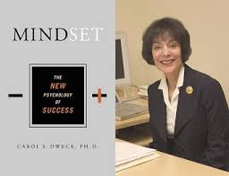
Growth Mindset
Carol S. Dweck: Mindset
‘IQ tests can measure current skills, but nothing can measure someone's potential. It is impossible to tell what people are capable of in the future if they catch fire and apply themselves.’
Notes:
On the screen as colleagues arrive. Explain about question and use of post its to ask questions.

Slide 2
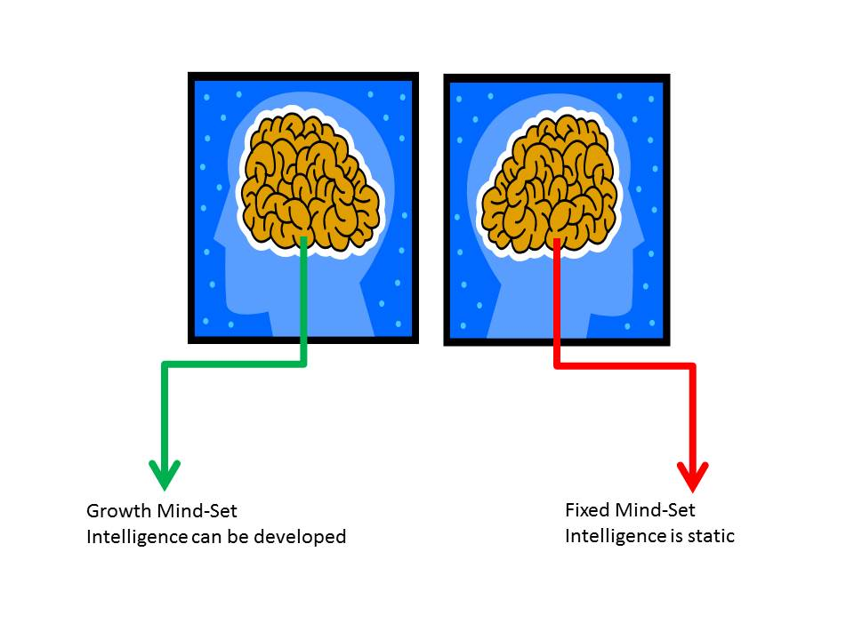
Mindset is often more important than your initial ability in determining whether you succeed in the long run.
Notes:
Brief introduction.

Slide 3
Growth
Mind-Set
Fixed Mind-Set
Believe that talent alone creates success
Believe that talents can be developed and great abilities can be built over time.
Reluctant to take on challenges
Well behaved pupils
Prefer to stay in their comfort zone
Higher Ability Pupils
View mistakes as an opportunity to develop
Are fearful of making mistakes
Hard Working Pupils
Resilient
Lower Ability Pupils
Think it is important to ‘look’ smart in front of others
Believe that effort creates success
Believe that talents and abilities are set in stone, you either have them or you don’t.
Think about how they learn
Notes:
Answers

Slide 4
Which Mindset do you model in your classroom?
Promotes a Fixed Mind Set | Promotes a Growth Mind-Set
Praising pupils for being smart | Praising effort and strategies
Formative comments that emphasis achievement | Formative comments that emphasis effort and application
Praising students for achievements that come easily | Building robust self confidence
Spending time documenting intelligence and ability | Spending time developing intelligence and ability
Directing pupils to which tasks to complete | Giving pupils a strong voice in the learning process and a sense of purpose
Boosting self esteem | Providing constructive criticism
Place importance on grades / levels rather than learning | Place importance on learning rather than grades / levels
Notes:
Share this table with colleagues. Ask colleagues to pick 3 of the strategies which they currently use which promote a fixed mindset, how they could they tweak these to promote a growth mindset? (How can you change your habits.)

Slide 5
If you hear yourself thinking
I can’t do this…
Notes:
Refer colleagues to the speech bubbles which will be positioned around the room.

Slide 6
Tell yourself
I can’t do this yet…
Notes:
Have these around the room on posters.

Slide 7
If you hear yourself thinking
I’m no good at this…

Slide 8
Tell yourself
I can become better at this…

Slide 9
If you hear yourself asking
What grade did I get?

Slide 10
Ask instead
What can I do to improve…

Slide 11
Progress Pyramid
One question I would like answered…
Two things I am not sure about yet….
Three things I have mastered…
Notes:
Activity 4 Group Task – Give each group a set of these 5 templates to discuss. Do they use anything similar in their classrooms? Are there any that they might consider using?

Slide 12
Colour in the arrow, up to the statement which best describes your current understanding.
 | I’m so confident - I could explain this to someone else!
 | I can get to the right answer but I don’t understand well enough to explain it yet.
 | I understand some of this but I don’t understand all of it yet.
 | I tried hard and I listened but I am finding this challenging. I will make sure that I get help with this next lesson.
 | I do not understand any of this yet. There are things I could do to be a better learner next lesson.

Slide 13
My Favourite MISTAKES
Means
I
Start
To
Acquire
Knowledge
Experience
Skills
A mistake that moved my learning on……

Slide 14
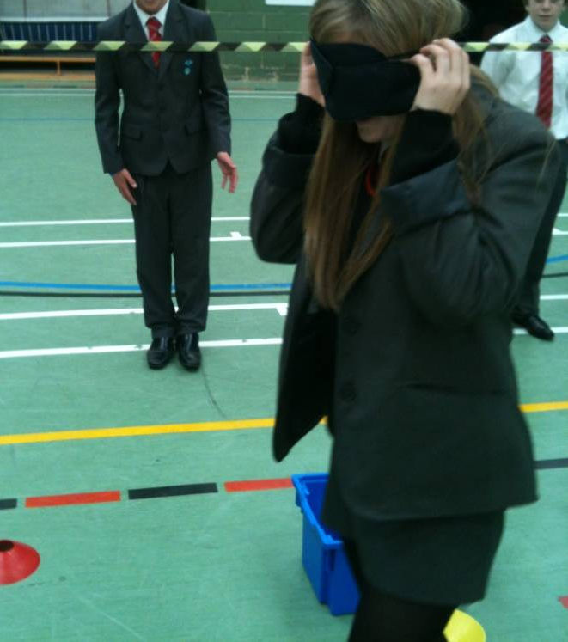
Year 11 Engagement – The Big Launch
To be a better learner you need to these attributes:-
Team work
Resilience / Determination
Problem Solving
Risk Taking / love of challenge
Motivation
Creativity

Slide 15
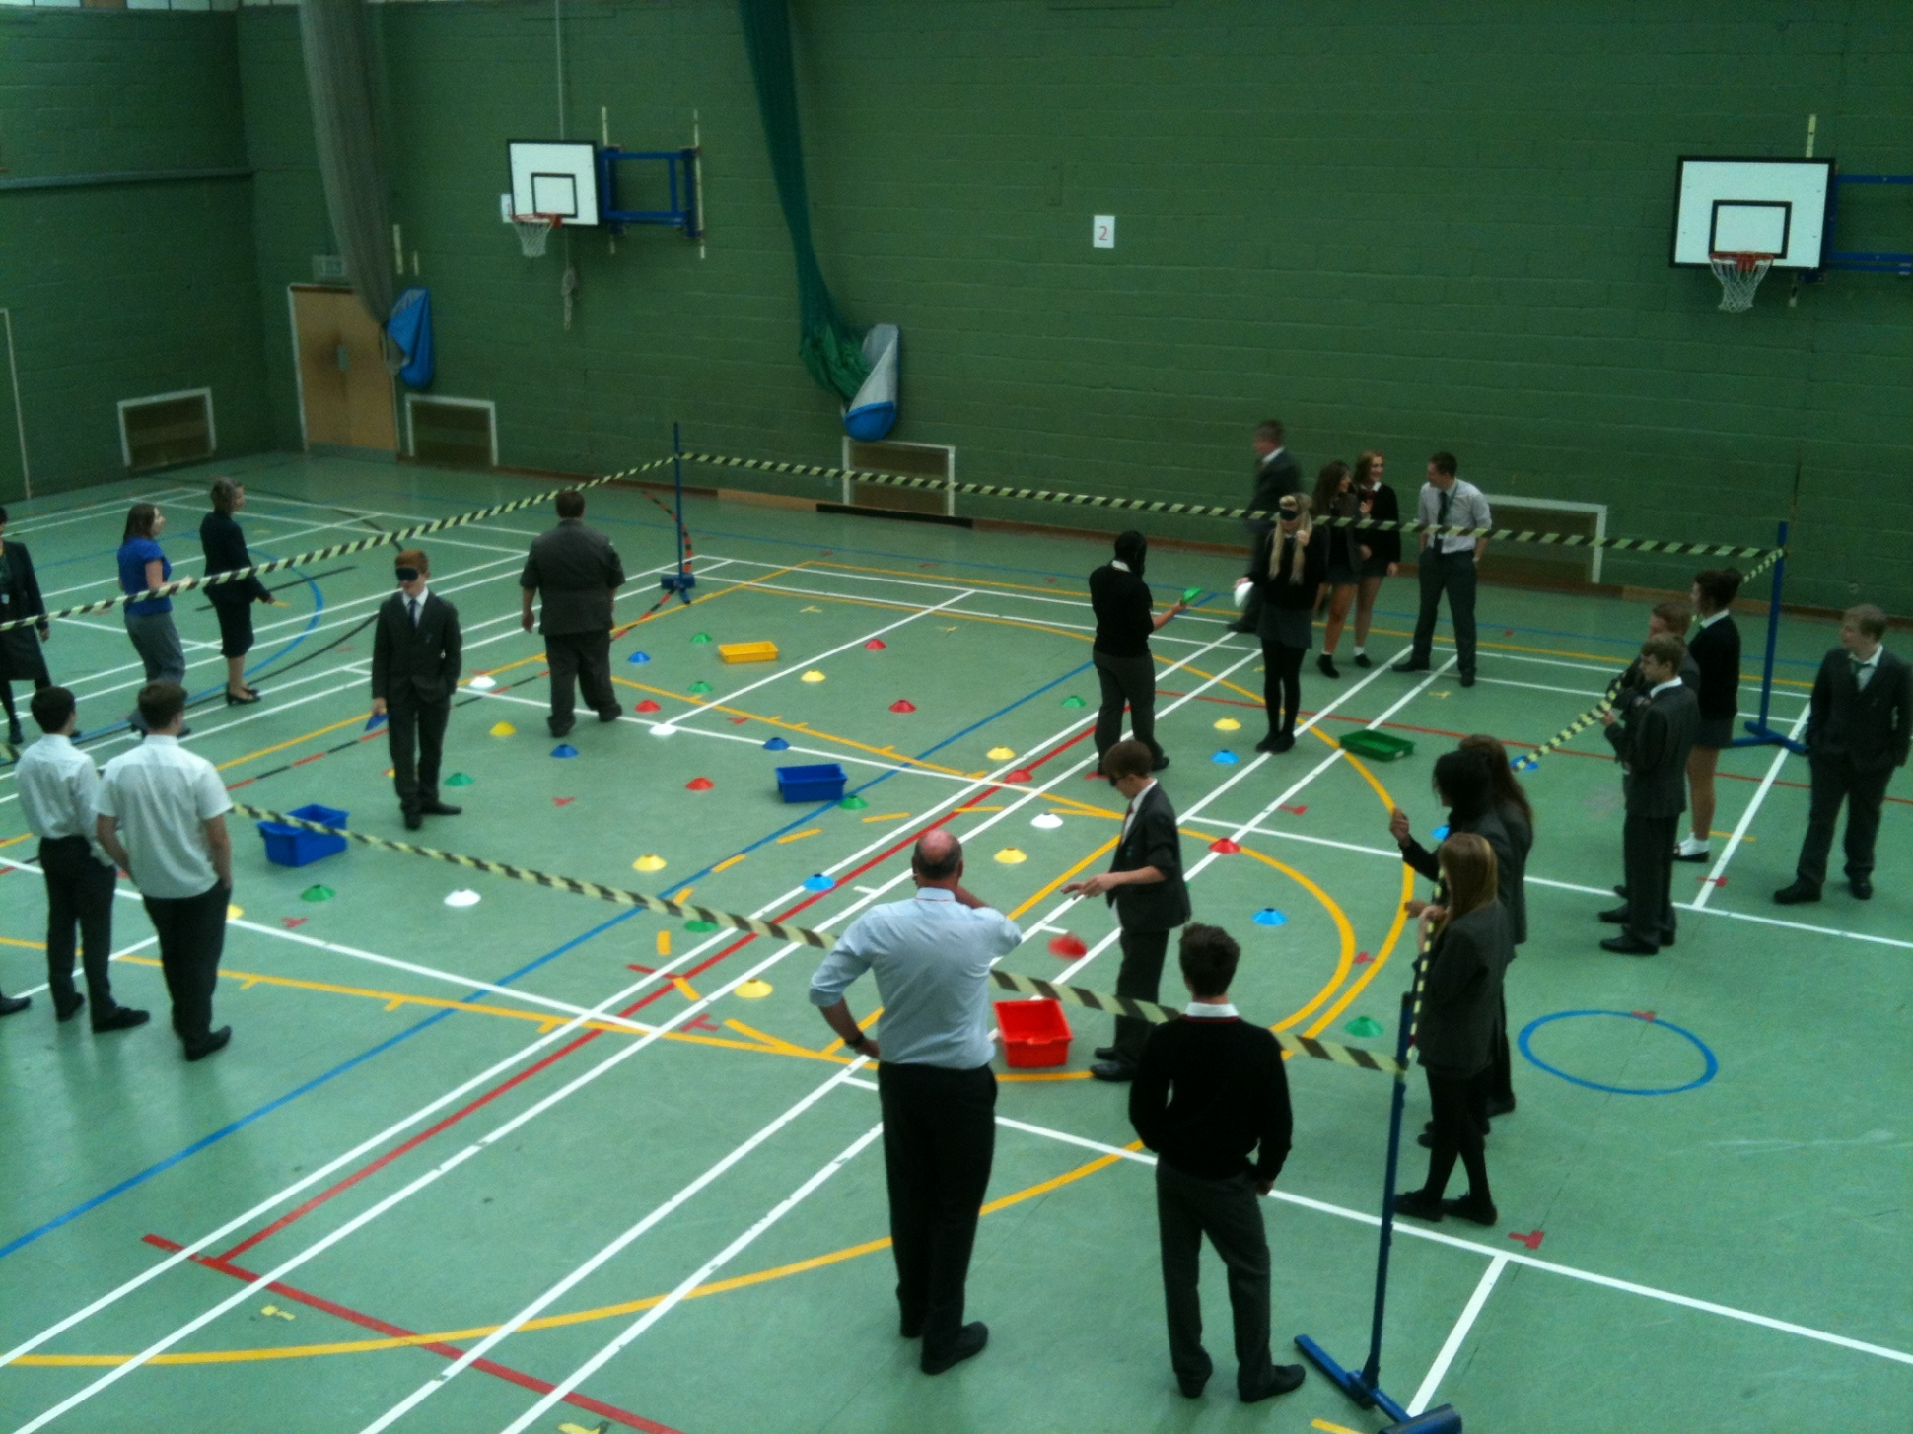

Slide 16
% of students who have gone up at least two entire grades since the module exam in year 10
15%
Notes:
How we celebrated progress in assemblies rather than grades.

Slide 17
These students are:-
Danielle | Up 2
Ellis | Up 2
Ellie | Up 2
Sam | Up 3
Chloe | Up 3
William | Up 3
Joe | Up 3
Briony | Up 3
Laurence | Up 4
Ryan | Up 4
Alexandra | Up 4
George | Up 4
Joe | Up 4
Thomas | Up 4
Joella | Up 4
Ryan | Up 4
Crystal | Up 4
Anna | Up 4
Ashleigh | Up 4
Connor | Up 4
Thomas | Up 4
Dan | Up 5
Holly | Up 5
Emily | Up 5
Notes:
How we celebrating progress in assemblies rather than grades.

Slide 18

Success Stories – Who is this?????
Target Grade D
Year 10
ATL 3
Unit 2 exam result U
Projected grade E
Year 11
ATL 6
November Exam C
Projected Grade B
If Dan can do it, so can you!
Interventions: Cookie Club, Maths Camp, ½ Term Revision,
Notes:
How we celebrating progress in assemblies rather than grades.

Slide 19
Developing a growth Mind-Set through the use of learning journeys

Slide 20
Dweck: I think that undue emphasis on testing can be harmful if it conveys to students that the whole point of school is to do well on these tests and if it conveys to them that how well they do on these tests sums up their intelligence or their worth as a student.
The same tests might not be so harmful if they were simply seen by educators and students as assessing students' skills at that point in time and as indicating what skills students need to work on in the future. In this case, the tests needn't dampen students' excitement about learning.

Slide 21
'Meaningful learning tasks give students a clear sense of progress leading to mastery.
This means that students can see themselves doing tasks they couldn't do before and understanding concepts they couldn't understand before.
Work that gives students a sense of improvement as a result of effort gives teachers an opportunity to praise students for their process.
(Dweck 2010)
Notes:
Discuss the importance of sharing progress with students in addition to sharing attainment.

Slide 22
The role of Learning Journeys in promoting a growth mind-set
Learning Journeys….
Give pupils a sense of purpose
Give pupils a strong voice in the learning process
Take pupils out of their comfort zone
Encourage pupils to challenge themselves
Place an emphasis on progress rather than attainment
Indicate to students what skills students need to work on in the future.

Slide 23
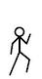
Grade | G | F | E | D | C
Angles | I can distinguish between acute, obtuse, reflex and right angles. | I can work out the size of missing angles at a point I can work out the size of missing angles on a straight line | I know the sum of the interior angles of a triangle and a quadrilateral. I can calculate missing angles in triangles and quadrilaterals | I can find alternate/corresponding angles, given two parallel lines. I can calculate the sum of the interior angles of polygons. I can calculate the size of an interior angle of a regular polygon. Given the exterior angle of a regular polygon I can calculate the number of sides. | I can solve multi-step problems involving interior / exterior angles of regular polygons.

Slide 24
Grade G Label each of these angles, obtuse, reflex, acute or right angle. | Grade F Calculate the size of the missing angles , showing your working out.
Grade E | Grade D Calculate the size of the missing angles
81⁰
32⁰
a
89⁰
42⁰
43⁰
76⁰
120⁰
120⁰
a
b
c
76⁰
84⁰

Slide 25
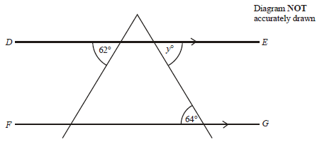
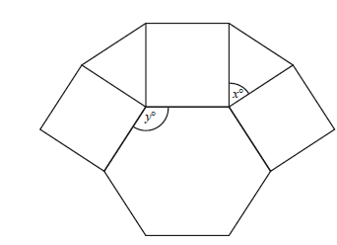
Grade D Find the size of the angle marked y. Give a reason for your answer. | Grade D The size of each exterior angle of a regular polygon is 40⁰. Work out the number of sides of the polygon. You must show all your working out.
Grade C
This is part of the design of a pattern found at the theatre of Diana at Alexandria. It is made up of a regular hexagon, square and equilateral triangle.
Write down the size of the angle marked x.
Work out the size of the angle marked y.
Show all your working out.

Slide 26
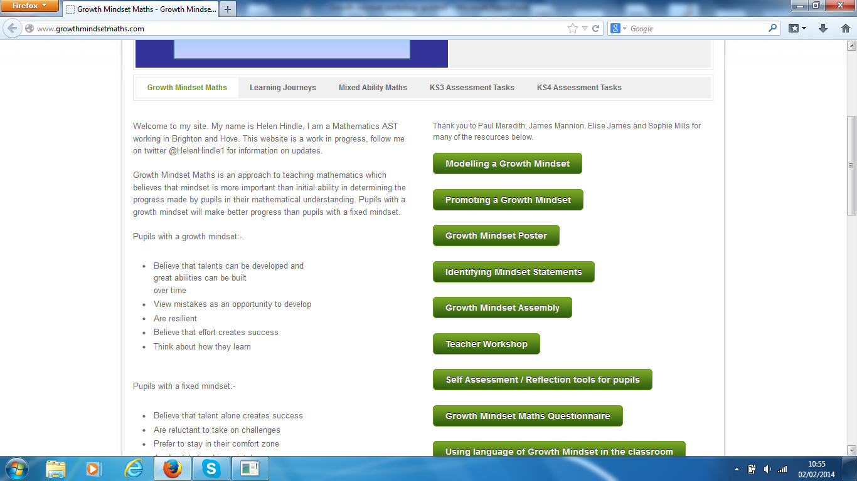
Notes:
Share Website

