Slide 1
LO To assess my understanding of Transformations | RAG
Key Words: Reflect, Communicate, Explain, Justify | 10/01/2015
Starter Activity
Complete the ‘Heard the Word Grid.’
Are there any key words that you have learnt or have a better understanding of now than you did at the start of this unit of work?

Slide 2
Grade | F | E | D | C
Transformations | I can recognise when shapes are symmetrical and when they are not. | I can reflect a shape in a oblique (45⁰) mirror line. | I can enlarge a shape by positive scale factor from a centre of enlargement and I can find a centre of enlargement and a scale factor. I can rotate shapes, through 90° or 180°, when the centre of rotation is a vertex of the shape, and I can recognise these rotations. I can translate shapes. | I can describe fully single transformations and combinations of transformations that will map one shape onto another shape. I can rotate shapes from a centre of rotation when the centre of rotation is not a vertex of the shape.

Slide 3
Key Words | Never heard before? | Heard of but not sure what it means? | Know what it means and can explain it in context Jot down your ideas here...
Reflect
Enlarge
Rotate
Translate
Scale Factor
Image
Object
Notes:
Pupils should complete this as their starter activity.

Slide 4
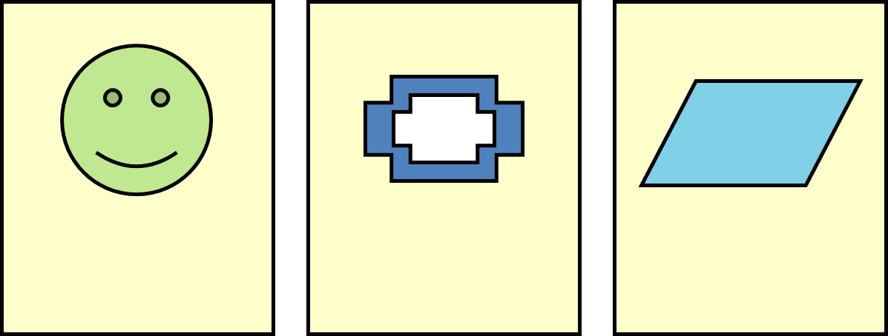
Grade F Questions
Which of these shapes does not have line symmetry?
Which of these shapes has one line of symmetry? Draw it on the shape.
Which of these shapes has two lines of symmetry? Draw them on the shape.
Shape A
Shape B
Shape C
Notes:
Print slides 2-10 two slides to a page.

Slide 5
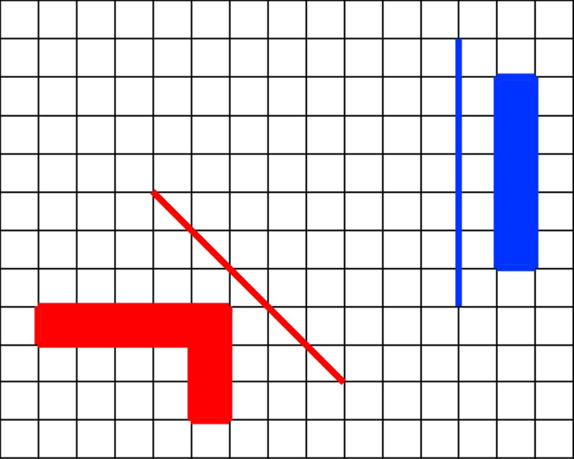
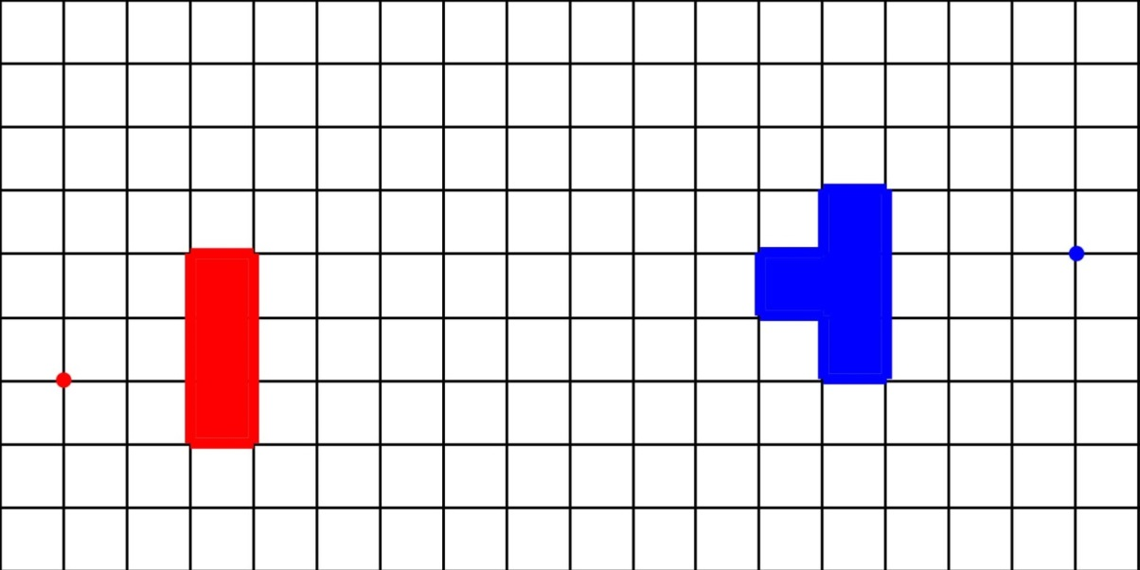
Grade E Questions
Grade D questions
Reflect each shape in the mirror line nearest to the shape.
What letter do your reflections make?
How can you check that you have reflected a shape correctly?
Enlarge these shapes from the centres of enlargements shown, by a scale factor of 2.
What letter do your enlargements makes?
A
Notes:
Print slides 2-10 two slides to a page.

Slide 6
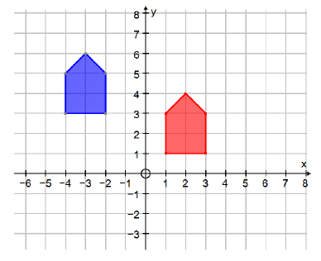
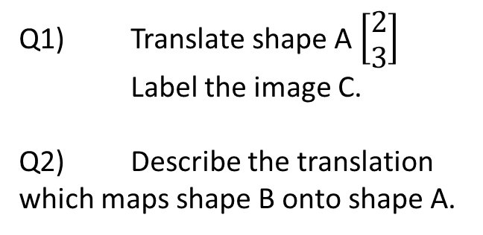
Grade D Questions
Rotate this shape 90° clockwise from the vertex (corner) marked with a dot.
Q1) Translate shape A $\left[\begin{aligned}2 \\ 3\end{aligned}\right]$
Label the image C.
Q2) Describe the translation which maps shape B onto shape A.
B
A
Notes:
Print slides 2-10 two slides to a page.

Slide 7
Grade C Questions
Reflect shape A in the line y = x to give its image. Label the image B.
Then rotate B through 90° about the origin to give its image. Label the image C.
What single transformation will map shape A onto C?
y
y = x
A
x
Rotate this shape 90⁰ clockwise using the centre of rotation (0,1)
What is the minimum information you would need to give someone to fully describe a rotation?
Notes:
Print slides 2-10 two slides to a page.

Slide 8
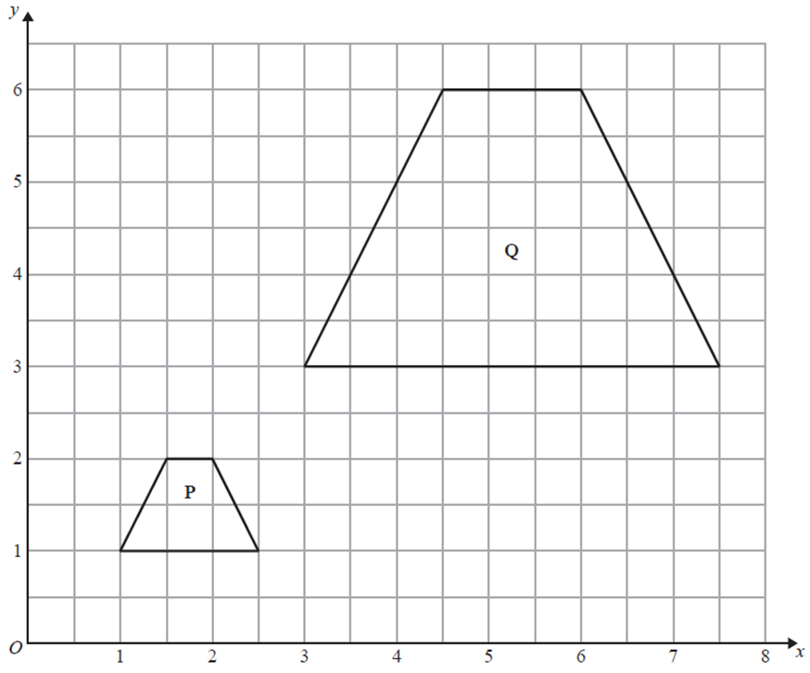
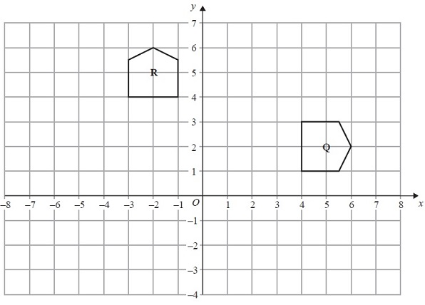
Grade C Questions
Describe fully the single transformation that maps shape P onto shape Q.
....................................................................................................................................
....................................................................................................................................
Describe fully the single transformation that maps shape R onto shape Q.
....................................................................................................................................
....................................................................................................................................
Notes:
Print slides 2-10 two slides to a page.

Slide 9
Use the space below to set yourself a question similar to the ones you were able to answer confidently. | Use the space below to answer the question that you have set yourself
My own question… | My answer…
My own question… | My answer…

Slide 10
Grade | F | E | D | C
Transformations | I can recognise when shapes are symmetrical and when they are not. | I can reflect a shape in a oblique (45⁰) mirror line. | I can enlarge a shape by positive scale factor from a centre of enlargement and I can find a centre of enlargement and a scale factor. I can rotate shapes, through 90° or 180°, when the centre of rotation is a vertex of the shape, and I can recognise these rotations. I can translate shapes. | I can describe fully single transformations and combinations of transformations that will map one shape onto another shape. I can rotate shapes from a centre of rotation when the centre of rotation is not a vertex of the shape.
Use the learning journey above to highlight the mathematical skills that you have now which you didn’t have at the start of the unit of work.
How much progress have you made?
What can you do to improve your skills as a learner in order to make even better progress?

Slide 11
My teachers probing question | My answer
What I will do to act upon my ‘Even Better If’’ comment
Strategy |  | Tick / Comments
Complete a mymaths lesson or booster pack
Use a revision guide or text book
Ask my teacher to explain during a lesson
Ask a peer to explain during a lesson
Ask someone at home to help
Attend a revision session at school
Attend homework club
Something else (describe your strategy here)
Notes:
Dialogue marking sheet.

