Slide 1
LO To assess my understanding of fractions, decimals and percentages. | RAG
Key Words: Reflect, Communicate, Explain, Justify | 21/09/2014
Starter Activity
Complete the ‘Heard the Word Grid.’
Are there any key words that you have learnt or have a better understanding of now than you did at the start of this unit of work?

Slide 2
Grade | G | F | E | D | C | B
Fractions, Decimals and Percentages | I can state the fraction of a shaded shape. I can find simple, equivalent fractions, decimals and percentages. I know how to recognise equivalent fractions. | I can solve fraction problems expressed in words. I can find simple percentages of a quantity. | I can find any percentage of a quantity. I can change decimals to fractions and fractions to decimals. | I can calculate percentage increases and decreases. | I can solve compound interest problems. | I can solve reverse percentage problems / I can work out an original amount.

Slide 3
Key Words / symbols | Never heard before? | Heard of but not sure what it means? | Know what it means and can explain it in context Jot down your ideas here...
Numerator
Denominator
Equivalent
Simplest Terms
Simple Interest
Compound Interest

Slide 4
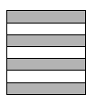
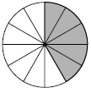
Grade G Next to each diagram write down the fraction of the shape that is shaded. Try to write each fraction in its simplest terms.

Slide 5
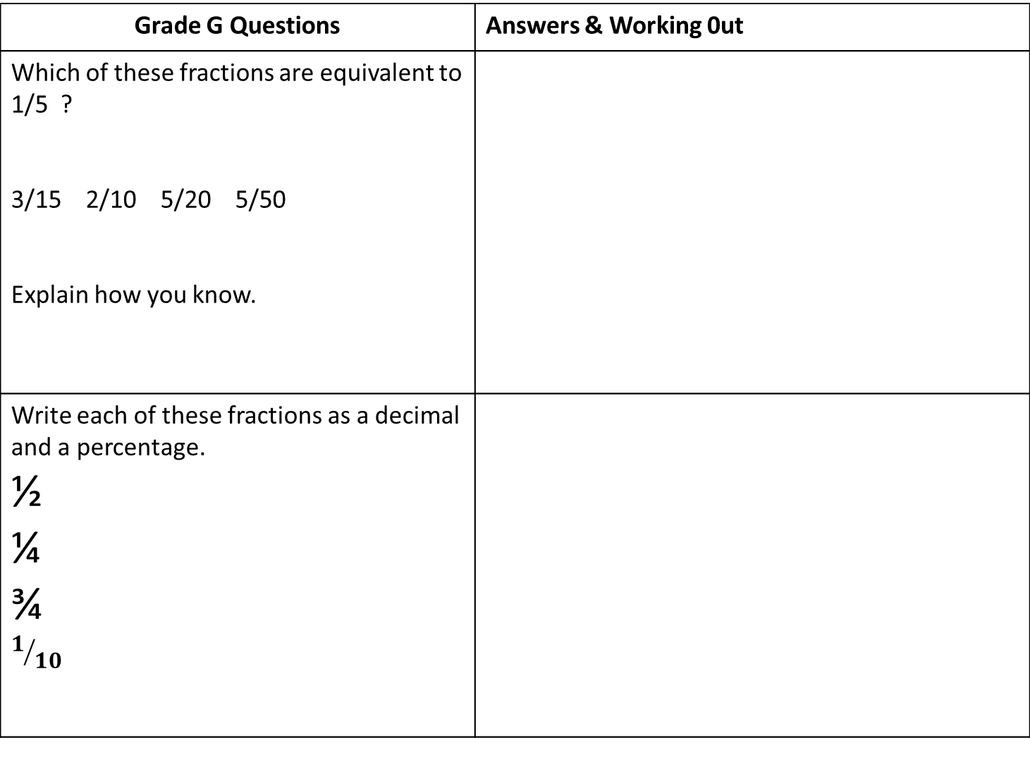
Grade G Questions | Answers & Working 0ut
Which of these fractions are equivalent to 1/5 ? 3/15 2/10 5/20 5/50 Explain how you know.
Write each of these fractions as a decimal and a percentage. ½ ¼ ¾ $$1/{10}$$
Notes:
Print slides 2-10 two slides to a page.

Slide 6
Grade F Questions | Answers & Working Out
(a) Work out 50% of £60 Work out 25% of 20 metres. Work out 10% of £240
There are 35 Smarties in a tube of Smarties. 2/5 of them are red and 1/7 of them are green. How many red Smarties are there? How many green Smarties are there? Explain how you worked this out.
Notes:
Print slides 2-10 two slides to a page.

Slide 7
Grade E Questions | Answers and Working Out
Change these fractions into decimals $1/{2 }$ $1/4$ $3/4$ $1/{10}$ $1/5$ $3/{20}$ Show all of your working out.
Change these decimals into fractions in their simplest form. Explain how you did it. 0.3 0.45 0.125

Slide 8
Grade E Questions | Answers and Working Out
One day a supermarket has 840 customers. 65% of the customers pay with a debit card. The rest of the customers pay with cash. Work out how many customers pay with cash.
There are 200 counters in a bag. The counters are blue or red or yellow. 35% of the counters are blue. 1⁄10 of the counters are red. Work out the number of yellow counters in the bag.

Slide 9
Grade D Questions | Answers & Working Out
James buys a car for £350. He sells the car for 23% less than he paid for it. How much did he sell the car for? Explain how you worked out your answer.
Petra booked a family holiday. The total cost of the holiday was £3500 plus VAT at 17.5%. Petra paid £902.50 of the total cost when she booked the holiday. She paid the rest of the total cost in 5 equal monthly payments. Work out the amount of each monthly payment.

Slide 10
Grade C Questions | Answers & Working Out
Jozef invests £1700 for 2 years at 4% per annum compound interest. Work out the value of his investment at the end of 2 years.
Liam invests £6200 for 3 years in a savings account. He gets 2.5% per annum compound interest. How much money will Liam have in his savings account at the end of 3 years?

Slide 11
Grade B Questions | Answers & Working Out
The normal price of a television is reduced by 30% in a sale. The sale price of the television is £350 Work out the normal price of the television.
In a sale, normal prices are reduced by 12%. The sale price of a DVD player is £242. Work out the normal price of the DVD player.

Slide 12
Use the space below to set yourself a question similar to the ones you were able to answer confidently. | Use the space below to answer the question that you have set yourself
My own question… | My answer…
My own question… | My answer…

Slide 13
Grade | G | F | E | D | C | B
Fractions, Decimals and Percentages | I can state the fraction of a shaded shape. I can find simple, equivalent fractions, decimals and percentages. I know how to recognise equivalent fractions. | I can solve fraction problems expressed in words. I can find simple percentages of a quantity. | I can find any percentage of a quantity. I can change decimals to fractions and fractions to decimals. | I can calculate percentage increases and decreases. | I can solve compound interest problems. | I can solve reverse percentage problems / I can work out an original amount.
Use the learning journey above to highlight the mathematical skills that you have now which you didn’t have at the start of the unit of work.
How much progress have you made?
What can you do to improve your skills as a learner in order to make even better progress?

Slide 14
My teachers probing question | My answer
What I will do to act upon my ‘Even Better If’’ comment
Strategy |  | Tick / Comments
Complete a mymaths lesson or booster pack
Use a revision guide or text book
Ask my teacher to explain during a lesson
Ask a peer to explain during a lesson
Ask someone at home to help
Attend a revision session at school
Attend homework club
Something else (describe your strategy here)
Notes:
Dialogue marking sheet.

