Slide 1
LO To assess my understanding of Algebraic Expressions | RAG
Key Words: Reflect, Communicate, Explain, Justify | 24/01/2015
Starter Activity
Complete the ‘Heard the Word Grid.’
Are there any key words that you have learnt or have a better understanding of now than you did at the start of this unit of work?

Slide 2
Level | Level 3 | Level 4 | Level 5 | Level 6 | Level 7 | Level 8
Algebraic Expressions | I understand the role of the = sign I can work out the missing number in a box. | I can use simple formula expressed in words. I can simplify expressions . I can find equivalent expressions. I can substitute positive values into simple expressions. | I can use simple formula. I can explain the difference between expressions. I can substitute positive and negative values into expressions. I understand the meaning of brackets in expressions. I can multiply a single term over a bracket | I can factorise linear expressions | I can multiply out and simplify quadratic expressions. | I can factorise quadratic expressions.

Slide 3
Key Words / symbols | Never heard before? | Heard of but not sure what it means? | Know what it means and can explain it in context Jot down your ideas here...
Expression
Term
Simplify
Substitute
Equivalent
Factorise
Expand

Slide 4
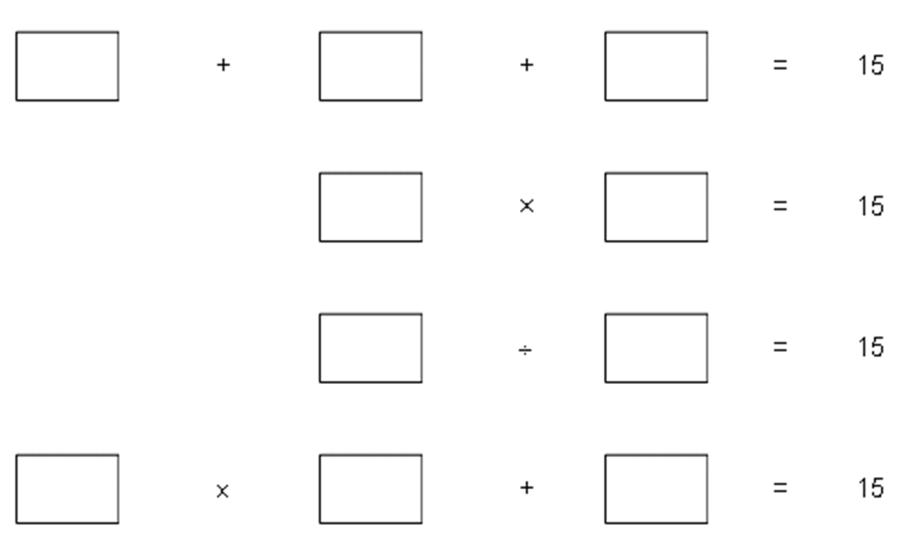
Level 3 Questions and Answers
Write in the boxes what the missing numbers could be.
Notes:
Print slides 2-10 two slides to a page.

Slide 5
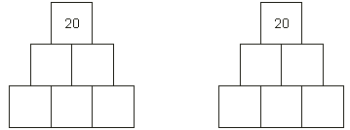
Level 3 Questions and Answers
Complete the number pyramid below in two different ways.
Notes:
Print slides 2-10 two slides to a page.

Slide 6
Level 4 Questions | Answers & Working 0ut
a + a + b + b + a + b + c + c + c + b Simplify this expression. Then write 4 expressions equivalent to the expression above.
a + a + b + b + a + b + c + c + c + b Substitute the values a = 2 b = 5 c = 4 to work out the value of the expression.
Notes:
Print slides 2-10 two slides to a page.

Slide 7
Level 5 Questions | Answers & Working 0ut
If a = 3 find the value of 2 + 5a What are the important steps in this calculation? What would you do first? Why? How would you continue to find the answer?
Write down an expression that is equivalent to 4p + 3q – 2 Are there any others?
Notes:
Print slides 2-10 two slides to a page.

Slide 8
Level 5 Questions | Answers & Working 0ut
Identify and correct the mistakes 4 ( b + 2 ) = 4b + 2 3 ( p – 4 ) = 3p - 7 | 4 ( b + 2 ) = 3 ( p – 4 ) =
Identify and correct the mistakes -2 (5 – b ) = -10 -2b 12 – ( n – 3 ) = 9 | -2 (5 – b ) = 12 – ( n – 3 ) =
Notes:
Print slides 2-10 two slides to a page.

Slide 9
Level 5 Questions | Answers & Working 0ut
Explain the difference between 2n and n + 2 | 2n means ……. n + 2 means ……….
Explain the difference between 3c + 5 and 3( c + 5 ) | 3c + 5 means ……. 3 ( c + 5) means ……….
Notes:
Print slides 2-10 two slides to a page.

Slide 10
Level 5 Questions | Answers & Working 0ut
Explain the difference between n² and 2n | n² means ……. 2n means ……….
Explain the difference between 2n² and (2n)² | 2n² means ……. (2n)² means ……….
Notes:
Print slides 2-10 two slides to a page.

Slide 11
Level 6 Questions | Answers & Working 0ut
If a = - 3 find the value of 4(2 + 5a) What are the important steps in this calculation? What would you do first? Why? How would you continue to find the answer?
Factorise these expressions 36y – 18 30y² + 30y
Notes:
Print slides 2-10 two slides to a page.

Slide 12
Level 7 Questions | Answers & Working 0ut
Multiply out these brackets and simplify the result: (x + 5)(x + 2)
Multiply out these brackets and simplify the result: (x + 2)²
Notes:
Print slides 2-10 two slides to a page.

Slide 13
Level 7 Questions | Answers & Working 0ut
Multiply out these brackets and simplify the result: (x + 4)(x - 3)
Multiply out these brackets and simplify the result: (x - 2)²
Notes:
Print slides 2-10 two slides to a page.

Slide 14
Level 8 Questions | Answers & Working 0ut
Factorise x² + 10x + 16
Factorise x² + -2x - 8
Notes:
Print slides 2-10 two slides to a page.

Slide 15
Use the space below to set yourself a question similar to the ones you were able to answer confidently. | Use the space below to answer the question that you have set yourself
My own question… | My answer…
My own question… | My answer…

Slide 16
Level | Level 3 | Level 4 | Level 5 | Level 6 | Level 7 | Level 8
Algebraic Expressions | I understand the role of the = sign I can work out the missing number in a box. | I can use simple formula expressed in words. I can simplify expressions . I can find equivalent expressions. I can substitute positive values into simple expressions. | I can use simple formula. I can explain the difference between expressions. I can substitute positive and negative values into expressions. I understand the meaning of brackets in expressions. I can multiply a single term over a bracket | I can factorise linear expressions | I can multiply out and simplify quadratic expressions. | I can factorise quadratic expressions.
Use the learning journey above to highlight the mathematical skills that you have now which you didn’t have at the start of the unit of work.
How much progress have you made?
What can you do to improve your skills as a learner in order to make even better progress?

Slide 17
My teachers probing question | My answer
What I will do to act upon my ‘Even Better If’’ comment
Strategy |  | Tick / Comments
Complete a mymaths lesson or booster pack
Use a revision guide or text book
Ask my teacher to explain during a lesson
Ask a peer to explain during a lesson
Ask someone at home to help
Attend a revision session at school
Attend homework club
Something else (describe your strategy here)
Notes:
Dialogue marking sheet.

